Slide 1


Slide 2

The 4 Rs
(Reduce, Reuse, Recycle, Rethink)

Slide 3







Environmental Sustainability
Use reusable options where appropriate.
Use of cloth fabric alternatives to SUPs, including clothes, barriers, and cleaning items.
Reusable PPE: laboratory coats to replace aprons, reusable face shields, and patient bibs.
Use of washable cups, dishes, and cutlery.
Reusable instruments (impression trays, suction tips, matrix band retainers).

Slide 4






Environmental Sustainability
A shift from a wasteful linear economy to a more sustainable circular economy in oral
healthcare is possible by proactively seeking and implementing recycling opportunities.
Segregate your waste and recycle.
Ensure your items are recyclable, quality over quantity.
Improve awareness and liaise with local authorities and support groups.
Identify and use pre-existing community recycling programmes to recycle separated paper and plastic parts of autoclavable bags and packaging.
Recycle office waste such as plastics, paper and medical shredding, and printer cartridges.

Slide 5

Knowledge Exchange - Research

Slide 6



Environmental Sustainability
Developing a research curiosity will increase your levels of knowledge and awareness and may help mitigate the environmental impacts of oral healthcare.
Be aware and have knowledge of important environmental research methodologies including Life Cycle Assessments (LCA).
Identify and select high-quality evidence that considers not only clinical effectiveness but also economic feasibility and environmental sustainability.
Use current and strong evidence-based knowledge to guide your decision-making at all stages of care.

Slide 7
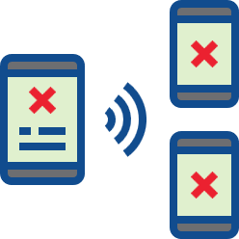

Environmental Sustainability
It is important to guard against misinformation and disinformation that may influence the objectivity of your decision-making.
There is confusion, misinformation, and disinformation in environmental sustainability that is influenced by the media and individual opinion.
Adopt a critical approach to all literature to avoid nonfactual and harmful information and agendas.

Slide 8
Procurement

Slide 9





Environmental Sustainability
Engaging and challenging stakeholders across the supply chain will support environmentally sustainable practices.
Work and engage with suppliers to assess their sustainability practices.
Apply pressure to suppliers to act in an environmentally sustainable manner.
Request recycling information for medical equipment from manufacturers.
Identify locally produced items and coordinate with local suppliers to reduce travel.
Reducing and reusing packaging.

Slide 10
Energy and
Water Consumption

Slide 11







Environmental Sustainability
Reducing energy and water consumption at all levels of oral healthcare is key to mitigating the environmental impacts of oral healthcare.
Use energy-efficient appliances (e.g., LED, fluorescent bulbs, light sensors, dimmer switches).
Make use of natural lighting and turn off the lights when not in use.
Turn off the tap when brushing.
Maintain and upgrade boilers and air conditioning units to ensure they are energy efficient.
Better use of windows and blinds to regulate temperature before using air conditioning.
Use appliances when fully loaded.

Slide 12
Waste Management

Slide 13



Environmental Sustainability
Developing and implementing a local environmentally sustainable waste management plan will mitigate your environmental impacts.
Implement the 4 Rs (reduce, reuse, recycle, rethink).
Identify and use effective waste disposal services that are close to the practice.
Incorporate the management of food waste, consider energy conversion or composting.
Use licensed handlers for off-site recycling of hazardous materials.
Use incineration facilities with energy recovery where possible.
Waste segregation.

Slide 14





Environmental Sustainability
Engaging and challenging all stakeholders will result in more environmentally sustainable waste disposal procedures.
Increase awareness of waste management and the associated costs.
Ensure effective waste segregation.
Ensure that waste contractors are complying with the appropriate local and national legislation at all levels, from collection to disposal.
Encourage contractors to diversify to include novel recycling opportunities.

Slide 15
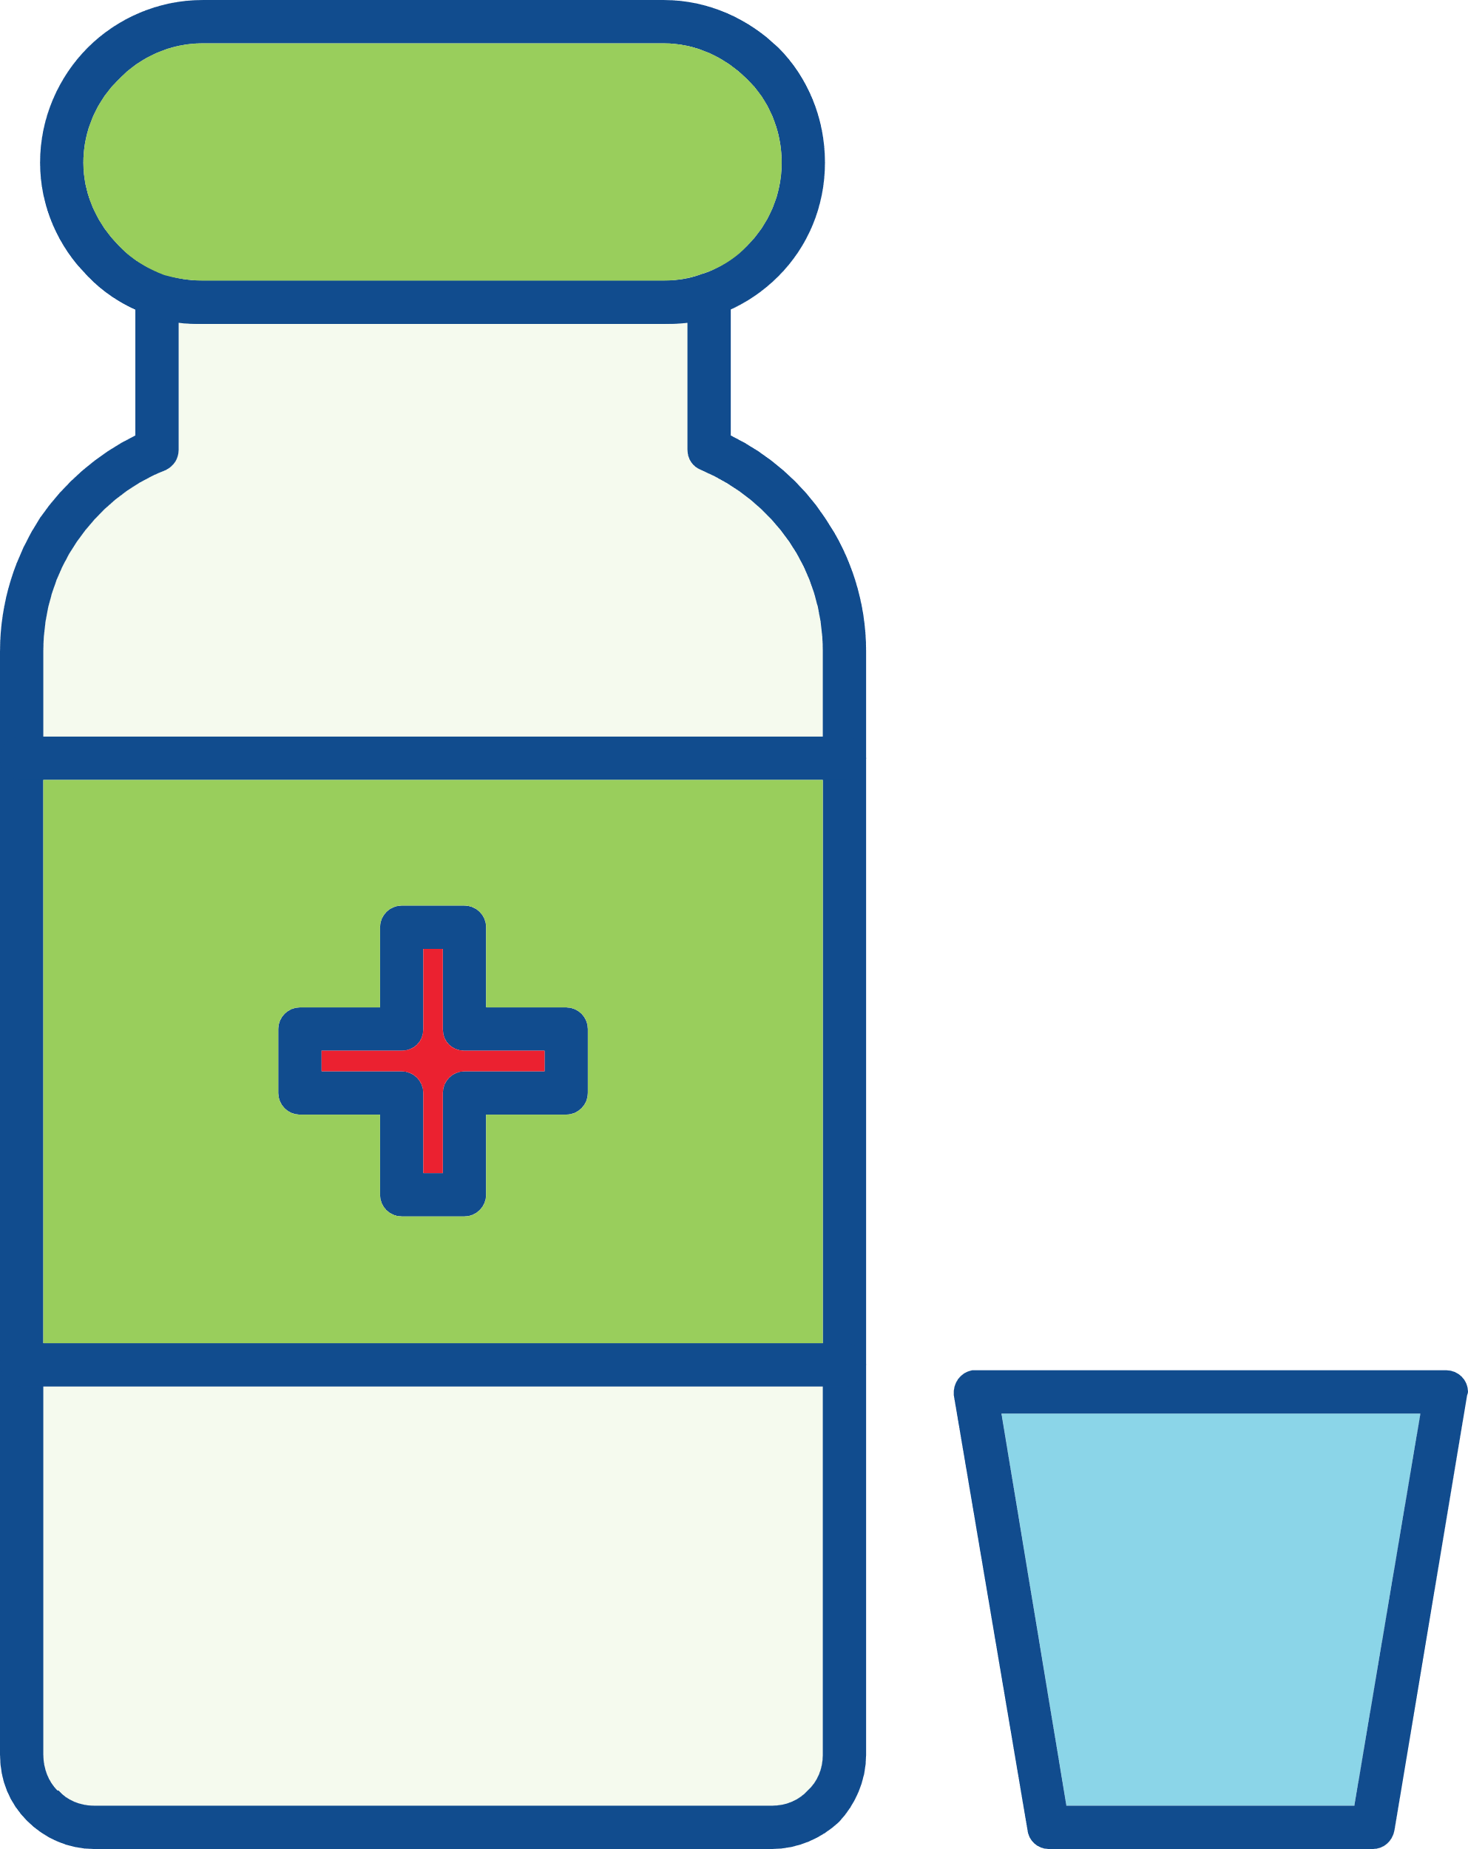




Environmental Sustainability
Reducing medicinal waste through evidence-based prescribing will mitigate the environmental impacts of the care you provide.
Only prescribe the required amount and dose.
Follow evidence-based national/international prescribing guidelines.
Adopt antibiotic stewardship to promote and monitor judicious use of antimicrobials.
Encourage patients to return unused medication to the pharmacy for safe disposal.
Discourage disposal down sink or toilet as this has a huge impact on biodiversity and antibiotic resistance.

Slide 16

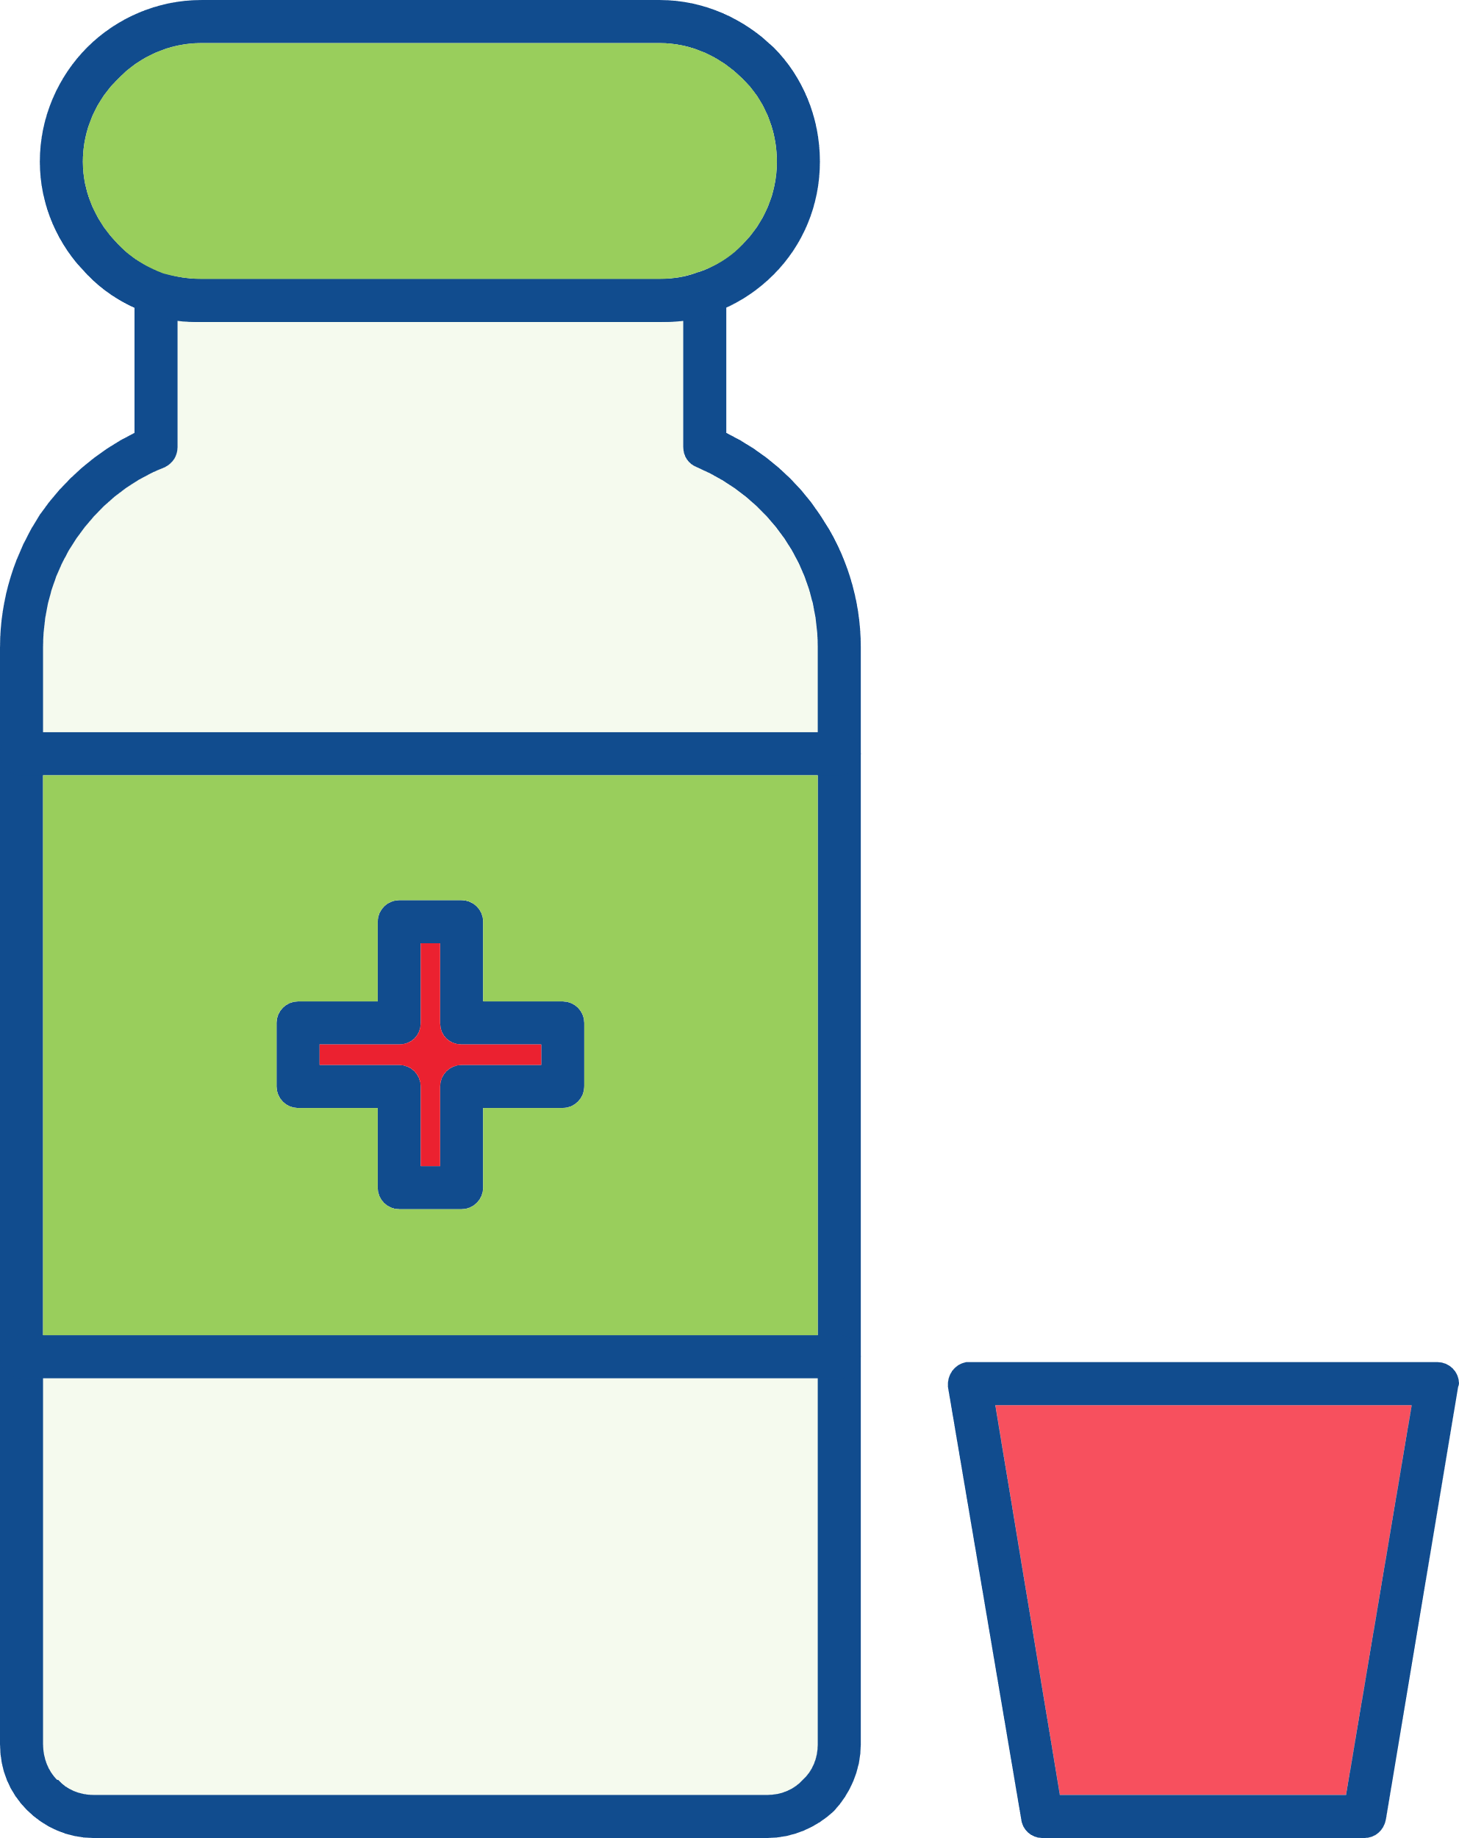
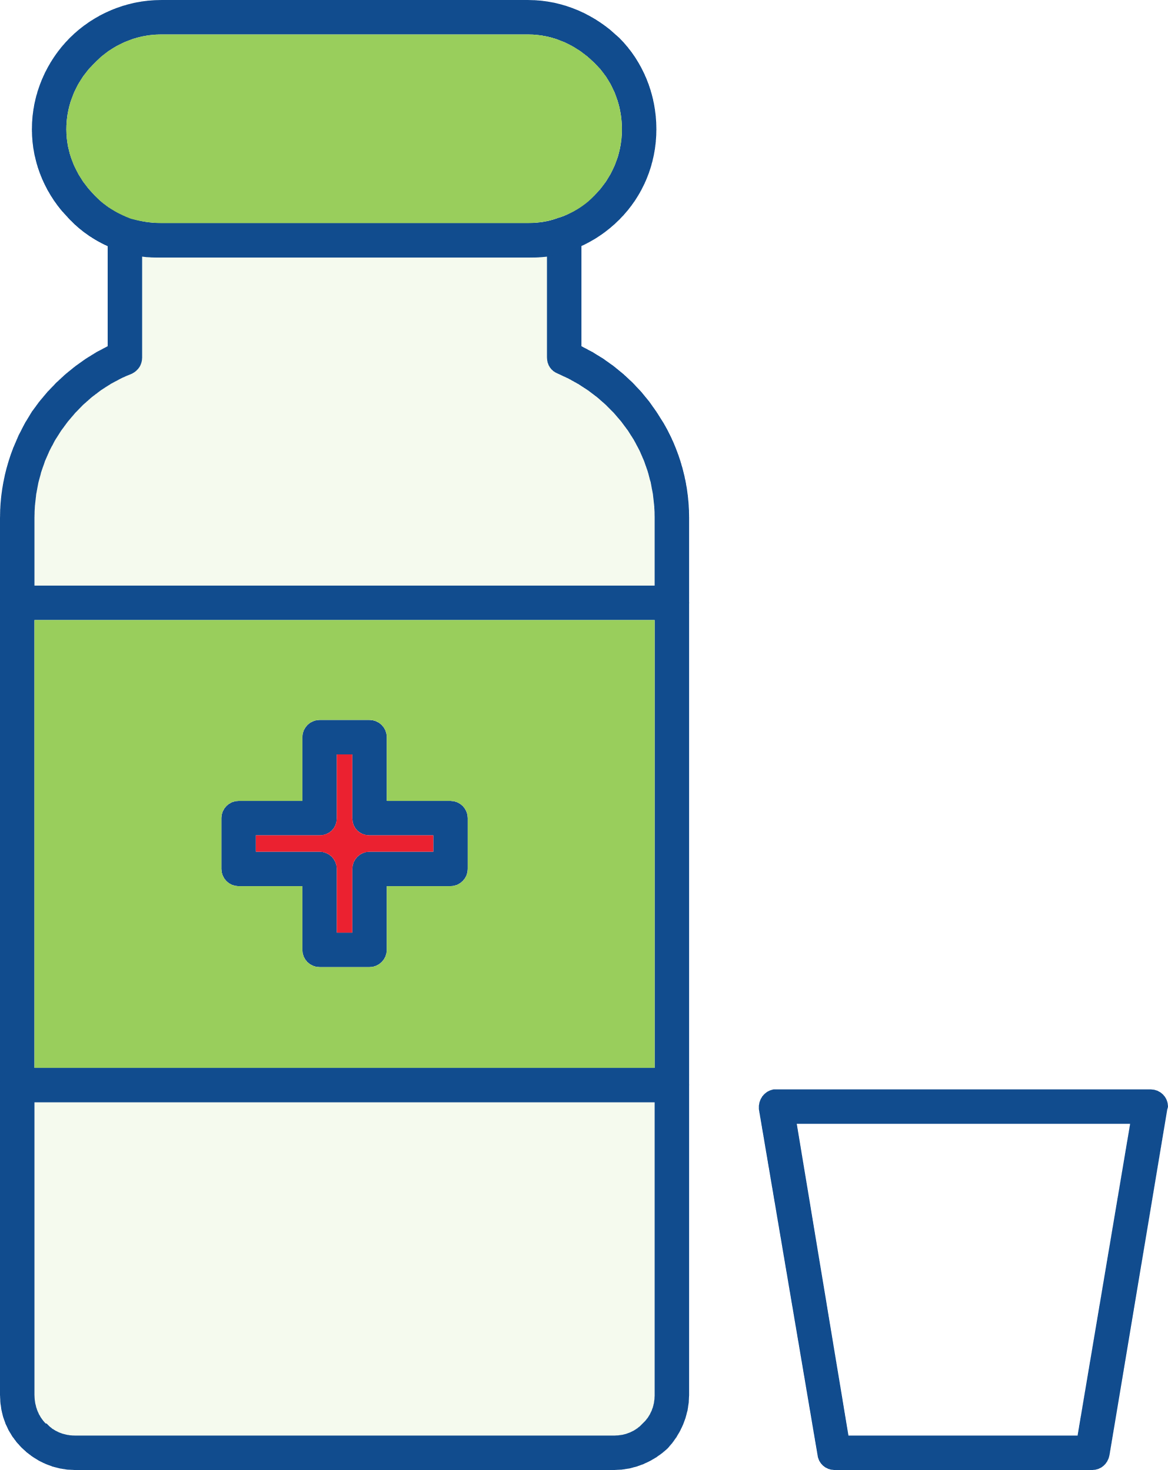
Environmental Sustainability
Reducing and recycling plastic waste will mitigate the environmental impacts of the care you provide.
Minimize single use plastics as much as possible and replace with reusable items including matrix band retainers, anaesthetic syringes, aspiration tips, Dappen’s pots.
Adopt reusables where possible to reduce single use plastic waste.

Slide 17



Sustainability in Dentistry MOOCs
MOOC 2
Practical Applications of Sustainability in Dentistry
Understand how to implement sustainable practices using the FDI Sustainability Toolkit and other resources and guidance.
MOOC 1
Sustainability in Dentistry
Discover the impact of oral healthcare on the environment and the basic concepts of sustainable practice.

Slide 18
Acknowledgements
Slides
Thank you to Dr. Jonathan Dixon (Clinical Academic Fellow in Restorative Dentistry) for supporting the development of these slides and associated resources, under the supervision of Prof. Nicolas Martin (Clinical Professor in Restorative Dentistry).
Research
Thank you to the authors of the research paper identifying a comprehensive strategy for the inclusion and delivery of Environmental Sustainability in the curriculum.
Dixon, J., Field, J., Gibson, E., and Martin, N. (2024). Curriculum content for Environmental Sustainability in Dentistry. Journal of Dentistry, 147, 105021. doi: https://doi.org/10.1016/j.jdent.2024.105021
Martin, N. and Mulligan, S. (2022). Environmental Sustainability Through Good-Quality Oral Healthcare. International Dental Journal. doi: https://doi.org/10.1016/j.identj.2021.06.005
Task Team
Thank you to the Sustainability in Dentistry Task Team for providing guidance and scientific expertise to ensure sound implementation of the entire Sustainability in Dentistry Project. The team includes:
Chair: Prof. Nicolas Martin (United Kingdom)
Members:
  Dr. Steven Mulligan (United Kingdom)
  Asst. Prof. Duygu Ilhan (Türkiye)
  Asst. Prof. Hasan Jamal (Saudi Arabia)
  Asst. Prof. Donna Hackley (United States of America)
  Dr. Mick Armstrong (United Kingdom)

Slide 19






Partners and Supporters
The Sustainability in Dentistry project is supported by our Partners and Sponsors:
Partners
Supporters

