Slide 1
FDI World Dental Federation
[Insert name of NLO]
FDI National Liaison Officer
[Insert name of NDA]

Slide 2
How to use this presentation?
This slide presentation is prepared for NLOs to help introduce and promote FDI to the Members of their Dental Association and explain the role of the NLO
Replace all of the red text with your own NDA/NLO information

Slide 3
About FDI
Founded in 1900, FDI was celebrating its 120th birthday in 2020!
One of the oldest international health profession organizations
Governed by the General Assembly, whose members elect the FDI Council (the administrative authority of FDI)
Made up of 190 National Dental Associations and specialist groups in 135 countries
Represents over 1 million dentists worldwide

Slide 4
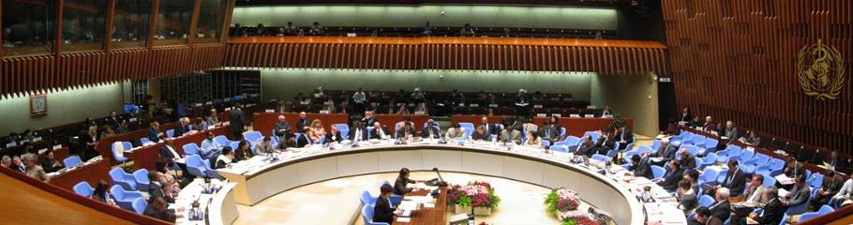
Non-governmental organization
Head office located in Geneva - ideal for interaction with other international health organizations
Official relations with the United Nations and the World Health Organization
Member of the World Health Professions Alliance and the NCD Alliance

Slide 5
FDI Vision and Mission
Vision: “A World with Optimal Oral Health”
Mission: FDI World Dental Federation is the leading global voice of the dental profession, working with members to improve oral health worldwide.

Slide 6
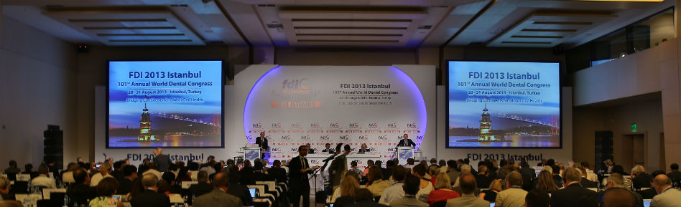
FDI General Assembly
The General Assembly is the supreme legislative and governing body of FDI. It holds annual meetings during the FDI World Dental Congress.
  Our Association was represented by: [Dr X…]

Slide 7
Governance of FDI
GENERAL ASSEMBLY
Regular (voting),
Associate, Affiliate and Supporting Members
REGIONAL ORGANIZATIONS
SECTIONS
COUNCIL,
COUNCIL COMMITTEES, SPECIAL COMMITTEES
STANDING COMMITTEES
WORKING GROUPS
TASK TEAMS
WORKING GROUPS
TASK TEAMS
EXECUTIVE DIRECTOR
HEAD OFFICE

Slide 8
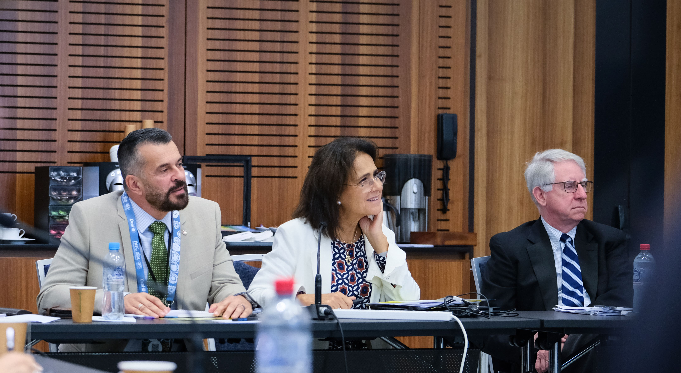
Council Committees, Special Committees and Standing Committees
Council Committees
  Executive Committee
  Finance Committee
  Remuneration Committee
  Special Committees
  Audit Committee
Standing Committees
Dental Practice Committee
Education Committee
Public Health Committee
Science Committee
Membership Liaison and Support Committee

Slide 9
Our participation in FDI Council and Committees
[Name]
[Committee]
[Role]
“[Brief quote]”
[insert picture]
[Name]
[Committee]
[Role]
“[Brief quote]”
[insert picture]
Each Regular Member association can nominate candidates. Shall we?

Slide 10
Regional Organizations and Sections
Regional Organizations
  African Regional Organization (ARO)
  Asia Pacific Regional Organization (APRO)
  European Regional Organization (ERO)
  Latin American Regional Organization (LARO)
  North American Regional Organization (NARO)
Sections
Chief Dental Officer/Dental Public Health Section
Defense Forces Dental Services Section
Women Dentists Worldwide Section

Slide 11
Current Task Teams and Working Groups
  Oral Health Observatory Task Team
  Advocacy Working Group
  World Oral Health Day Working Group
  Health and Safety in the Dental Workplace Task Team
  Policy Statements Editorial Working Group
  Governance Task Team
  Sustainability in Dentistry Task Team
  Digital Cleft Care Task Team
  Whole Mouth Health Task Team
  Dental Materials & Products Surveillance Task Team
  Oral Health for an Ageing Population Task Team
  Whole Body Health Task Team
  Ethics Working Group
  Preventing AMR and Infections Task Team
  Standing Committee Chairs Working Group
  Vision 2030 Implementation and Monitoring Expert Group
  Regional Continuing Education Task Team
  Master CE Adhesive and Aesthetic Task Team
  Integrated Electronic Health Records in Dentistry Task Team
  Mental Health and Well-being Task Team

Slide 12
Our participation in Task Teams and Working Groups
[Name]
[Committee]
[Role]
“[Brief quote]”
[insert picture]
[Name]
[Committee]
[Role]
“[Brief quote]”
[insert picture]

Slide 13
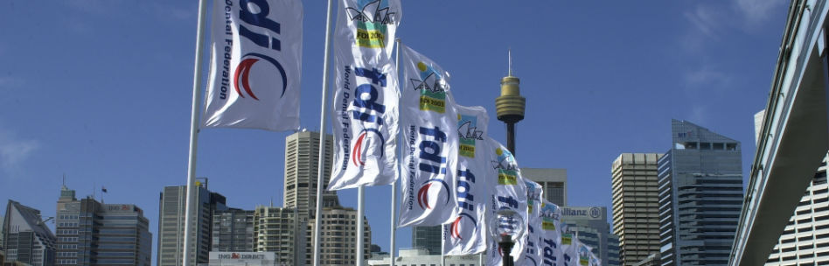
Membership benefits
Participation in decision-making on oral health at global level
Access to Continuos Education Programme
Possibilities of funding national oral health projects through the World Dental Development Fund, Smile Grant, WOHD award
Opportunity to apply for the annual Travel Grant to attend the FDI World Dental Congress (valid for NDAs in low income or low-middle income countries)

Slide 14
Membership benefits
Possibility to receive other support designated for members only
Right to nominate candidates for FDI Standing Committees and Council
Access to FDI Projects on an ad hoc basis
Support for World Oral Health Day held on 20 March

Slide 15
Membership benefits
One free registration to World Dental Congress
Access to international organisations: WHO, UNEP, ISO
Worldwide networking with other oral health professionals
Use of FDI member logo as prescribed

Slide 16

Member Support
Continuing education programmes – over 30 events per year in 25 countries
Advice and support for the development of NDAs
FDI Policy Statements, Guidelines and Toolkits

Slide 17
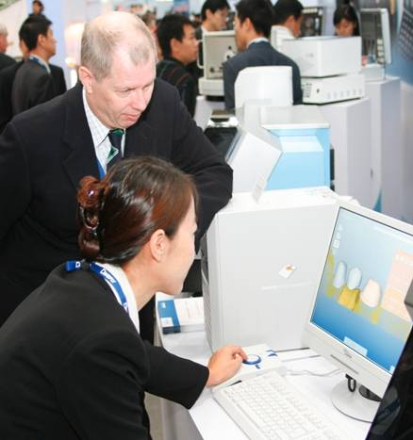
FDI World Dental Congress
World Dental Parliament
(more than 350 representatives)
Scientific Programme
(more than 200 sessions)
Exhibition
(over 6000 m²)

Slide 18
Important dates before the Congress
February: Deadline for submission of NLO Reports (for free NLO Registration at the Congress)
May: Congress early bird registration deadline
May: Call for GA, 90 days before the meeting
May: Deadline for Nominations for the Committees
June: Deadline for Nominations for the Council
July: General Assembly Binder (including reports from Regional Organizations) circulated 60 days before the meeting

Slide 19
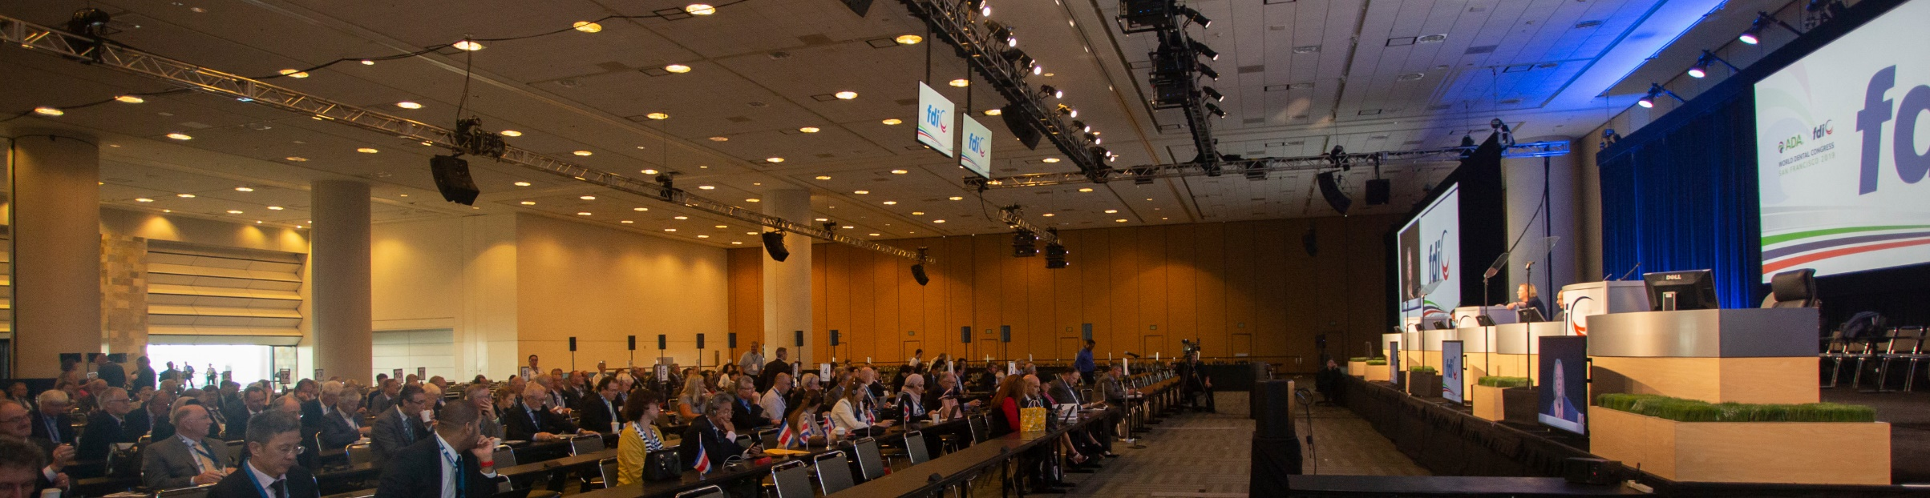
World Dental Parliament Meetings
General Assembly A, General Assembly B
Open Forum 1, Open Forum 2, Open Forum 3
NLO Forum
World Oral Health Forum
WOHD Launch

Slide 20


World Dental Congresses
Istanbul 2024 Shanghai 2025

Slide 21

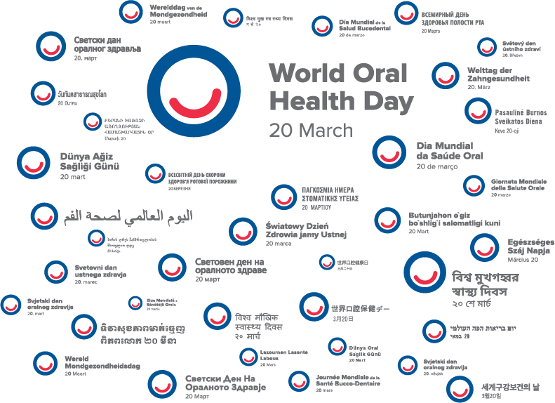
World Oral Health Day
Next 20 March we will organize…
www.worldoralhealthday.org

Slide 22
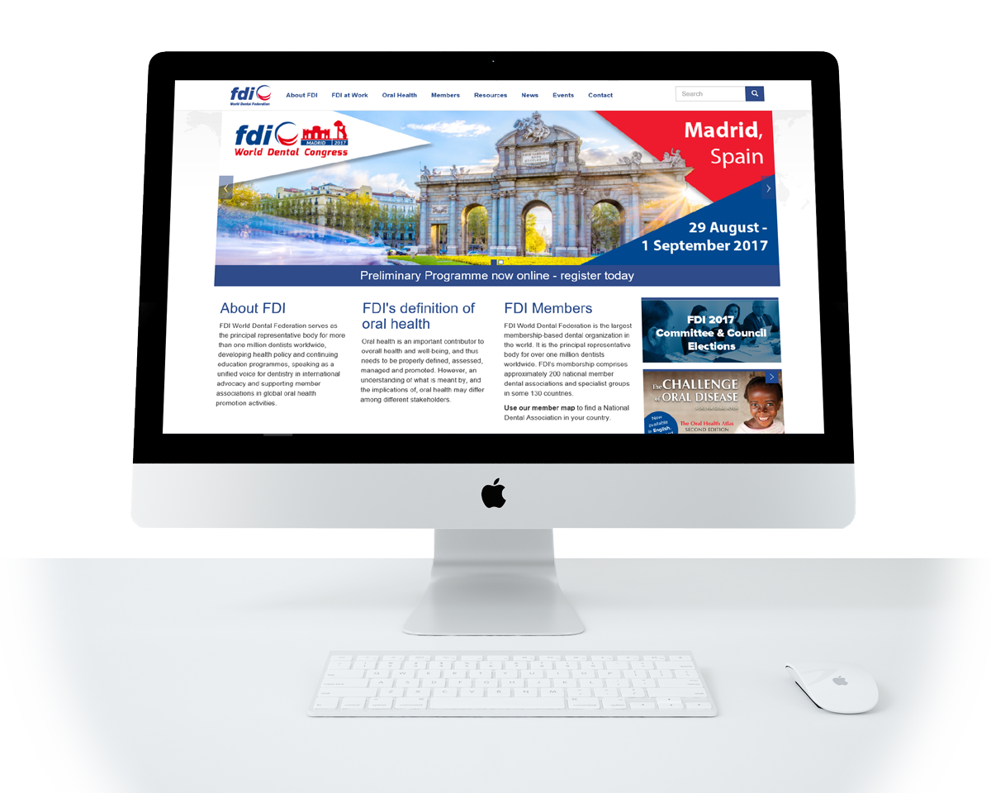
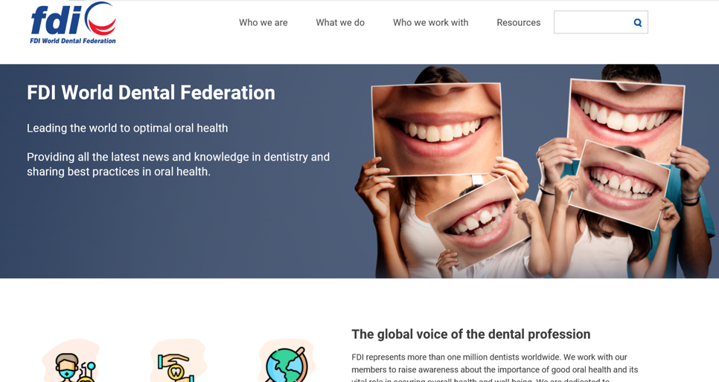
Visit www.fdiworlddental.org

Slide 23
Next Steps
This year we are going to work more closely with FDI by:
Our objectives for working more closely with FDI this year…

