Slide 1
Regional CE Programme
Laetitia Reymond, Congress & Events Director
Notes:
Education= event-

Slide 2
Regional CE Programme
Facilitating Knowledge Transfer to advance and promote the art and practice of dentistry
Support dentists and dental teams in developing, mid-income and countries in economic transition
Promote evidence-based clinical practices
FDI CE Directors partner with NDAs, industry and individuals
Notes:
Go where most needed.

Slide 3
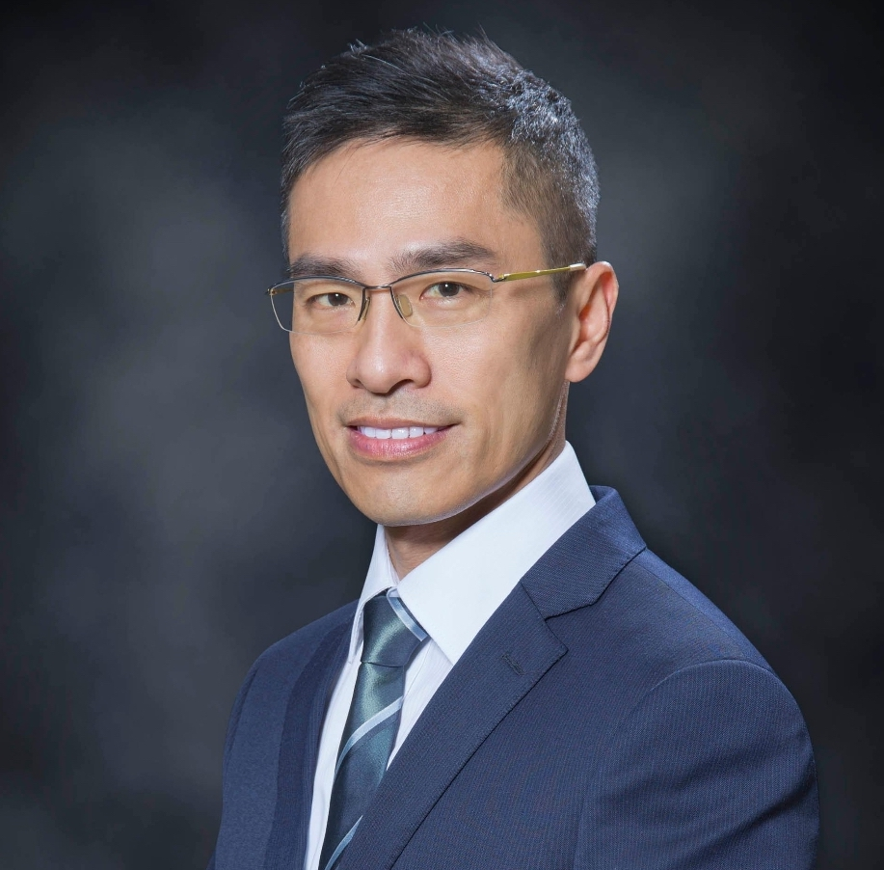
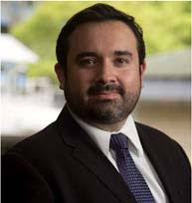
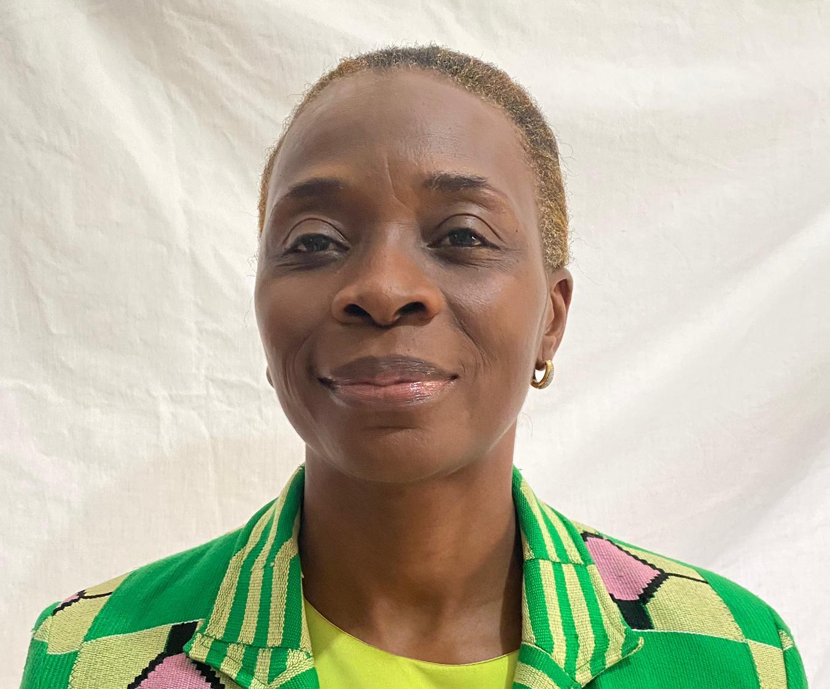
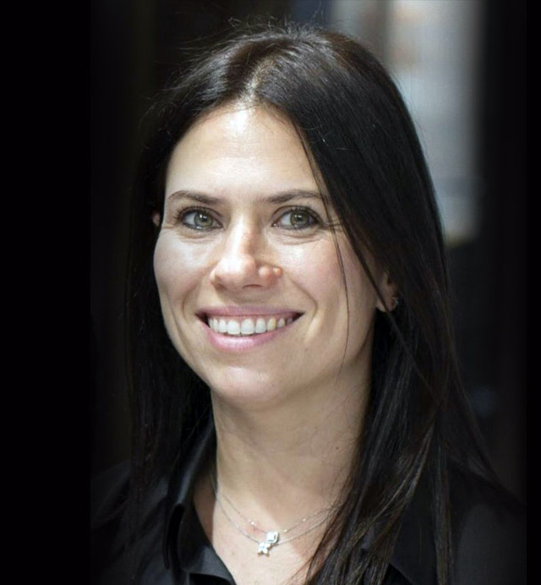
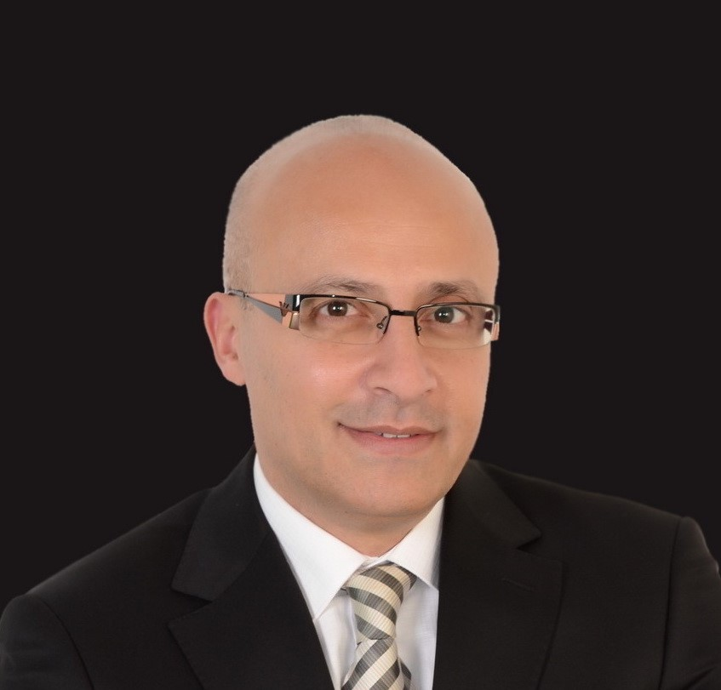
Regional CE Programme
Asia Pacific
Dr Simon Ho Kam Yuen
Hong Kong SAR, China
Process
Team
CE Events are organized by the Regional CE Programme Directors, in collaboration with National Dental Associations (NDAs), to fit their specific needs
We encourage NDAs to contact the CE Programme Director of their region to plan CE Events
Only FDI members (with paid membership dues) can host FDI CE Events
Latin America
Dr Mauricio
Montero-Aguilar
Costa Rica
Africa
Until September 2022
Dr Yolande Koffi Gnagne
Côte d’Ivoire
Middle East
Prof. Dr Hani A. Salam
United Arab Emirates
Europe
Prof. Hande Sar Sancakli
Türkiye

Slide 4
Multiple options to fit your needs
Format
in person
online
Programme type
Stand alone
Within your national event

Slide 5
What can we help you with?
Content Management
Promotion
Hot topic identification
Extensive international speaker database
Selection and coordination of speakers
FDI acknowledgment: dedicated logos for your promotion
Additional promotion on FDI digital networks: web calendar, social media, etc.
FDI branded promotion toolkit for your social medias
Financial support
Speaker travel fees reimbursement
Technical support
For online courses:
Platform set-up
Speaker briefing
registration

Slide 6
Timeline
NDA need assessments
Budgeting & funding research
Programme creation / approval
Speaker selection
Communication & promotion
Event delivery
Event assessment & statistics
Max 1 month
after event
Sept – Nov
Year -1
Min 2months
before event
Dec - Feb
It’s time the ideal time to plan for 2023!

Slide 7
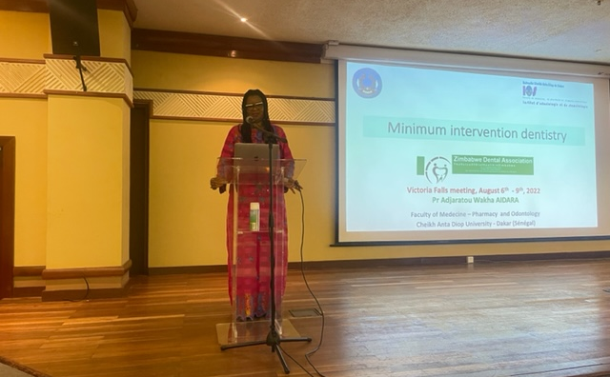
Key success factors
Anticipation
Clear needs definition
Constant communication
Proactive promotion
Smooth reimbursement process
Feedback collection
Participants
speaker
Organizer

Slide 8
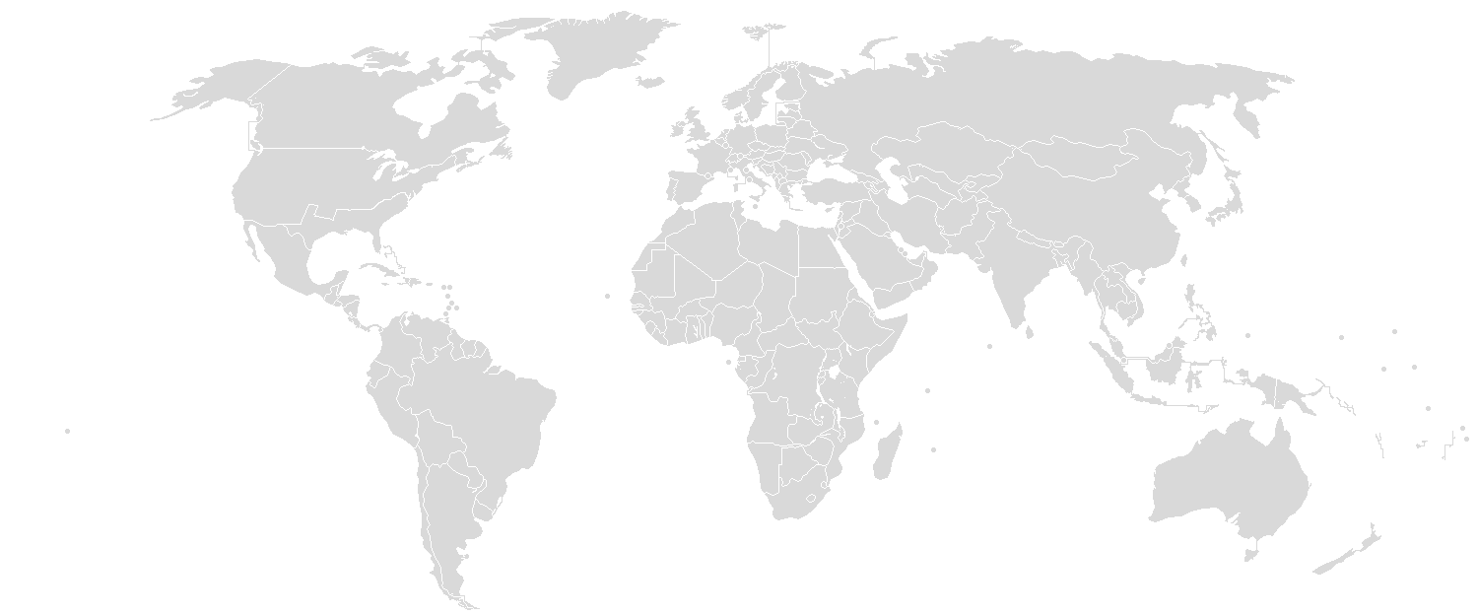
2022 Figures
Europe
12 events
13 courses
7 NDAs
Middle East
3 events
56 courses*
3 NDAs
Asia Pacific
11 courses
5 NDAs
Latin America
5 events
13 courses
5 NDAs
Africa
8 courses
3 NDAs
29 Events for a total of
101 courses
in collaboration with 23 NDAs
*African Health ExCon was not an FDI event but the Middle Est CE Director was able to provide speakers for 50 sessions.

Slide 9
Strategy
The way forward….
Notes:
FDI is looking at the way forward with the CE programme
1st workshop during mid-year
2nd workshop
Define priorities
Identify innovatives ways in presenting CE programmes. + thanks for need assesssment
Will keep you posted.

Slide 10
Any questions?
Thank you for your attention
Notes:
I will be pleased to answer any questions

