Slide 1
Tobacco Control in Tanzania
Deogratias B. Kilasara
President Tanzania Dental Association
Notes:
Better Tobacco Control on front page than just tobacco!

Slide 2
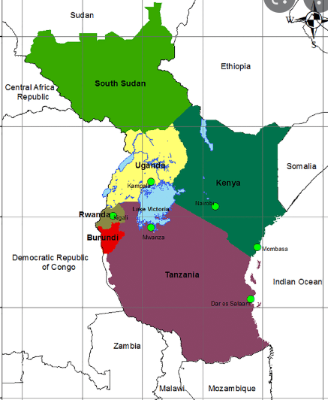
Introduction: snapshot of tobacco in Tanzania
Over 90% of tobacco grown in Tanzania is mainly for foreign markets, while the remaining 10% is for the domestic market (Tanzania GATS report 2018)
Tobacco use (both smoking and smokeless) was 27.8% (2000) and 8.7% (2020) (2.6 million adults, 14.6% of men, and 3.2% of women) (World Health Organization, Global Health Observatory Data Repository)
Tobacco sector employs 2,500,000 people (Ministry of Agriculture, Livestock and Fisheries)
Increase in export of traditional goods in April 2022 was recorded in clove, coffee, cotton and tobacco (Monthly Economic Review Bank of Tanzania)
32% of all cancers tobacco-related (Lutgard K et al 2010)
Tobacco related diseases are reported to cause about 17,200 (4%) of all deaths in the country (Tanzania GATS report 2018)
Notes:
4.8% of students, 6.5% of boys, and 2.4% of girls currently used any tobacco products
3.6% of students, 4.8% of boys, and 1.8% of girls currently smoked tobacco
1.3% of students, 1.5% of boys, and 0.7% of girls currently smoked cigarettes
2.1% of students, 2.9% (Global Youth Tobacco Survey, 2016)

Slide 3
Tobacco production 1961-2018

Slide 4
The Global Adult/Youth Tobacco Survey (GATS & GYTS)-Tanzania
is the global standard for systematically monitoring adult/youth tobacco use, second hand smoking and tracking key tobacco control indicators.
WHO identified a set of six evidence-based tobacco control strategies, that are most effective in reducing tobacco use
Monitoring tobacco use and prevention policies.
Protecting people from tobacco smoke.
Offering help to quit tobacco use.
Warning about the dangers of tobacco.
Enforcing bans on tobacco advertising, promotion and sponsorship.
Raising taxes on tobacco.

Slide 5
Tobacco cessation & Attempt to quit smoking
Global Adults Tobacco Survey 2018
48.4% of tobacco smokers attempted to quit
36.5% of tobacco smokers advised to quit
76.8% of planned /thinking of quitting
65.8% attempted without any assistance while 6.8% used pharmacotherapy (nicotine replacement),
used counselling 24.0% and 9.4%other methods.
Quit without assistance in rural, 63.5% vs 70.2% in the urban

Slide 6
GYTS highlights
Global Youth Tobacco Survey, 2016
4.8% of students, 6.5% of boys, and 2.4% of girls currently used any tobacco products
3.6% of students, 4.8% of boys, and 1.8% of girls currently smoked tobacco
2.1% of students, 2.9% of boys, and 0.9% of girls currently used smokeless tobacco
17.3% of students were exposed to tobacco smoke at home.
34.1% of students were exposed to tobacco smoke inside enclosed public places

Slide 7
Tobacco control approach in Tanzania
Regulatory approach
An act to impose tax on the sale of Tobacco 1970
Tobacco Products (Regulation) Act, 2003
WHO Framework Convention on Tobacco Control (FCTC) in 2007
National Tobacco Control Strategic Plan (NTCSP) (2010-2015).
The Tobacco Products (Regulations) Act (Designation of Inspector (CAP. 121) (2021)
Service Approach
Educational approach
Role of health (oral) professionals
Notes:
National Tobacco Control Strategic Plan 2021 – 2026 ready, awaiting signature next month

Slide 8
Roadmap to Tobacco Control in Tanzania & Current Tobacco Control Policies in Tanzania
Before WHO FCTC
Act to impose tax on sale of Tobacco 1970
Tobacco Product Regulation Act (TPRA) 2003
WHO FCTC
WHO Framework Convention on Tobacco Control (FCTC) 2005
Tanzania ratified the convention in 2007
After WHO FCTC
National Tobacco Control Strategic Plan (NTCSP) (2010-2015) & (2021 – 2026)
The Tobacco Products (Regulations) Act (Designation of Inspector (CAP. 121) (2021)
Tobacco advertising, promotion, sponsorship, packaging & labelling
Tobacco products regulation Government Notice No. 478 (2014
Notes:
FCTC adopted by the WHA 27 May 2003 and came into force 27 February 2005
Tobacco Products Regulation Gov Notice… pro-tobacco companies, so is the Designation of Inspectors 2021 - not worthy mentioning

Slide 9
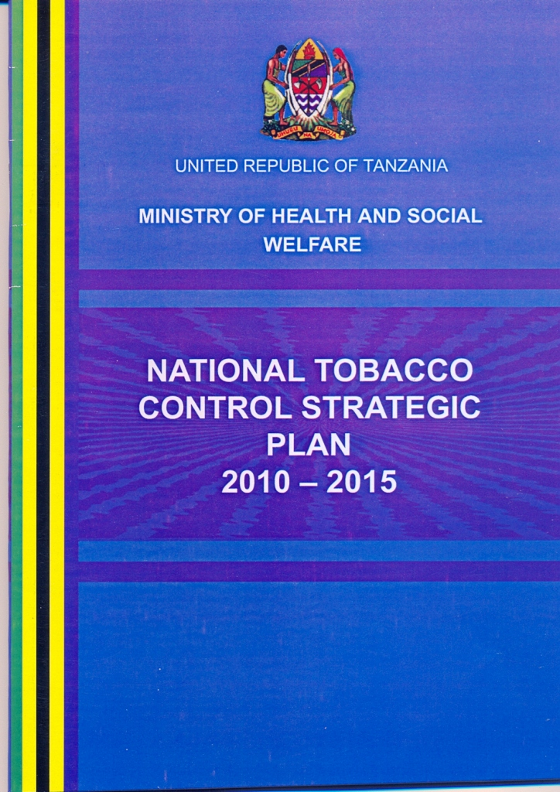
Implementation of WHO Framework Convention on Tobacco Control in Tanzania 2007- 2022
Article 5.0: General Obligation
MOH established NCD unit, Technical Advisory Committee on Tobacco Control (TACT)
National Tobacco Strategic Plan (NTCSP)-2010-2015
Article 5.3: Tobacco Industry Interference (TII)
FCTC requires parties to protect public health policies against TII
TI claimed effective TC will result to loss of revenue to Government and farmers
TI increased its cooperate social responsibility
Tanzania scored 73 points (high level of interference)
Notes:
2020 & 2021 Tanzania scored 73 (https://globaltobaccoindex.org/country/TZ)

Slide 10
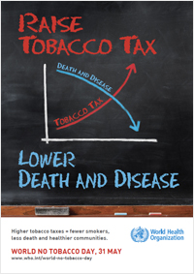
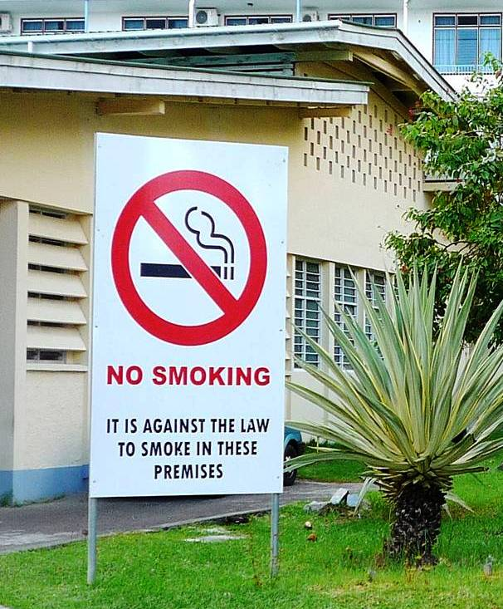
Implementation of WHO Framework Convention on Tobacco Control in Tanzania 2007- 2022
Article 6.0 Price and tax measures to reduce demand for tobacco
Article 8: Protection from exposure to tobacco smoke
No effective legislation however smoking in public is enforced by due to awareness carried out by TTCF and partners, people complain when one smoke in public places
WHO recommends 70% excise tax (not done in 2019 tax rate was 32.1%)
No designated area created for smoking in public
Notes:
WHO recommends at least 75% of the retail price
Tanzania has among the lowest tobacco taxes in Africa
WHO recommends 100% smoke free – no designated smoking areas

Slide 11
Implementation of WHO Framework Convention on Tobacco Control in Tanzania 2007- 2022 cont…
Article 9 & 10: tobacco product regulation and disclosure
Some brands of cigarettes manufactured for export complied with disclosure of contents as required by importing countries while similar brands made for local consumption do not
Article 11: Packaging and labelling of tobacco products
Studies indicates that Tanzania did not carry effective health warnings as required
Tanzania Medicine and Drug Authority (TMDA) was designated inspector for the purposes of the Act to carry out inspection, enforcement and regulate Tobacco products and issue Notice (TPRA CAP 121 of 2021)

Slide 12
Implementation of WHO Framework Convention on Tobacco Control in Tanzania 2007- 2022 cont…
Article 12: Education, communication, training and public awareness
TTCF and partners with MoH and WHO country office have been carrying out intensive education and sensitization campaigns
Article 13: Tobacco advertising, promotion and sponsorship
Results indicates TI has stepped up its advertising activities, outdoor, at points of sale (POS) and brand stretching and promotion and sponsorship campaigns in an effort to counter increasing TC advocacy campaigns
Art 12 – Sensitisation seminar for Champion MPs on NCDs (60 in total) by TTCF
Notes:
Art 12 – Sensitisation seminar for Champion MPs on NCDs (60 in total) by TTCF
Promotion of YES cigarette by Premium Tobacco Co. – using young celebrities (Harmonize named Tanzania Ambassador for Yes Cigarettes) - https://globaltobaccoindex.org/country/TZ

Slide 13
Implementation of WHO Framework on Tobacco Control in Tanzania 2007- 2022 cont…
Article 17 & 18: Provision of support for economically viable alternative activities and protection of the environment and health persons
June 2017, FCTC held a meeting on the Implementation of Articles 17 & 18 at Dar-es-Salaam, Tanzania, emphasized safeguarding farmers and the environment.
The articles with the lowest implementation rates continue to be:
Article 18 (Protection of the environment and the health of persons)
Article 19 (Liability)
Article 17 (Provision of support for economically viable alternative activities).
Survey showed that more than 90% of tobacco farmers in Ruvuma shifted to alternative crops
Notes:
Art 17 & 18 - Since 2006 – to-date, TTCF has been working with tobacco farmers in Namtumbo District, Ruvuma Region, more than 90% have adopted alternative crops, registering great improvement in their socio-economic status. Graph shows increased maize & rice production (2006 -2014). Similar increase in other crops (sunflower, sesame, beans, groundnuts) (https://doi.org/10.18332/tid/84721)
Art 11 – Tanzania – cigarette packages have 30% text heath warnings; WHO recommends graphic health warnings covering at least 50% front and back

Slide 14
Tanzania Tobacco Control Forum (TTCF)
Following ratification of WHO FCTC in 2007, the Tobacco Products Regulation Act (2003) (TPRA, 2003) needed review to conform with FCTC
Review identified loophole, TTCF collaborated with MoH to develop new bill which was supposed to be tabled in Parliament in November 2009: but this did not happen to date.
TTCF & partners engaged MP and changed their perception about tobacco on its contribution to economy and need to have a new legislation that conforms with FCTC
TTCF & partners engaged tobacco farmers in Ruvuma Region where more than 90% adopted alternative crops

Slide 15
Tanzania Dental Association: Tobacco cessation project
Social-Demographic
Male 72.5%
Age range: 31-50 (70%)
Work experience>10 yrs (55%)
DDS & above 55%, DT& ADO 45%
TDA tobacco cessation survey July 2022
Number of respondent 132
TC counselling to tobacco user 50%
Tobacco cessation (TC) training=15%
Enquire tobacco use= 15%
Role of oral health personnel on TC 92.5%
Wish to enroll to training 95%

Slide 16
Tanzania Dental Association: Tobacco cessation project
Currently there are no any tobacco cessation projects in Tanzania.
Two TDA members attended tobacco cessation training which was organised by FDI in 5th November 2021.
FDI supported TDA with 1000 Euros, to launch a project that will last for 3 years(August 2022-July 2025). FDI tool kits were used and will be used to carry out this project.
Focus on: oral health professionals, then finalist students in Oral training University and mid-level training institutions

Slide 17
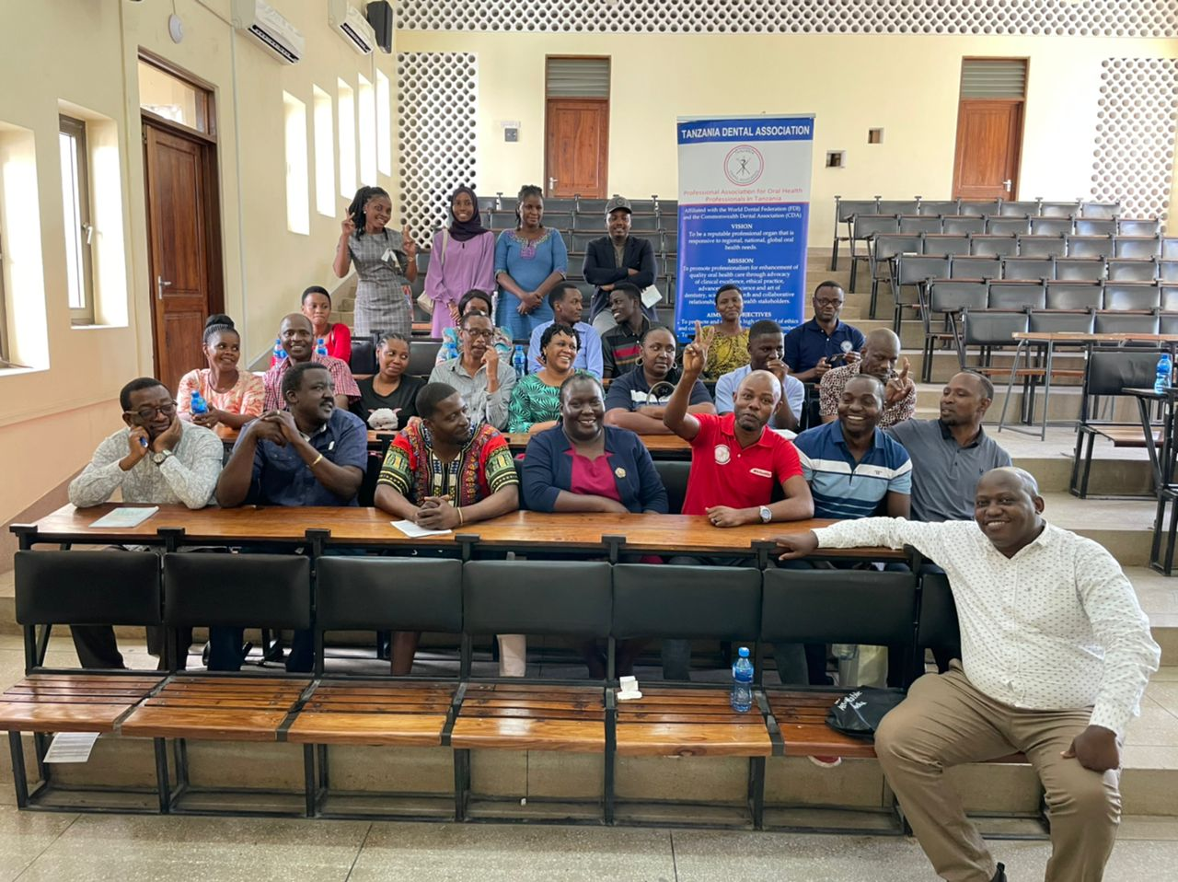
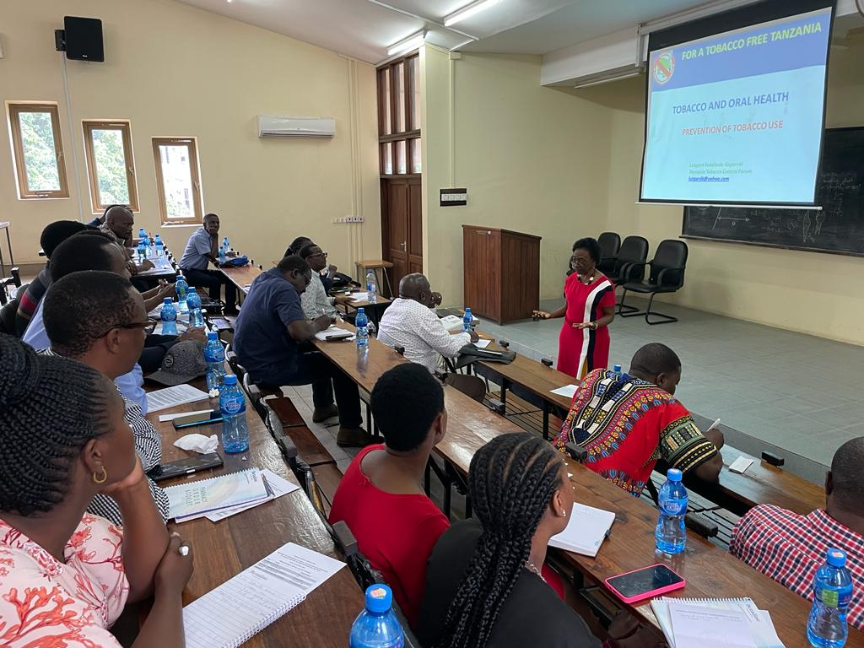
Tanzania Dental Association: Tobacco cessation project
Tanzania has 31 administrative regions divided in 7 zones
Four cohorts of 30-40 will be trained btn August 2022 and June 2023 to serve as ToT and cascade training to others.
Picture: 1st cohort training (Eastern Zone) on 8th August 2022 in Tanzania

Slide 18
Conclusion
Tobacco production in Tanzania continue to rise since independency to date
Advocacy on implementation of WHO FCTC is still ongoing by TTCF and partners
No dedicated centers to help smokers to quit in Tanzania
TDA is engaging on education approach
counselling smokers to quit
Online content for e-learning platform in Tanzania for health professionals
Advocate training institutions to include tobacco cessation counseling to their curriculum

Slide 19
References
Tanzania Global Adult Tobacco Survey (2018): Tanzania National Bureau of Statistics. https://www.nbs.go.tz/
World Health Organization, Global Health Observatory Data Repository. https://www.who.int/data/gho/data/themes/theme-details/GHO/tobacco-control
World Health Orfanization, NCD Microdata Repository https://extranet.who.int/ncdsmicrodata/index.php/catalog/810/related-materials
Ministry of Agriculture, Livestock and Fisheries
Monthly Economic Review Bank of Tanzania. https://www.bot.go.tz/Publications/Regular/Monthly%20Economic%20Review/en/2022060917051207.pdf
(Cancer in Tanzania Studies at Ocean Road Cancer Institute & Muhimbili National Hospital 2009)
Boesen, Jannik ; Mohele, A. T The "success story" of peasant tobacco production in Tanzania : the political economy of a commodity producing peasantry. (1979), Publisher Uppsala
Lutgard Kagaruki: Community based advocacy opportunity for tobacco control: Experience from Tanzania; Global Health Promotion Supp(2): 41–44; (2010), DOI: 10.1177/1757975910363932
Lutgard Kokulinda Kagaruki, Alternative crops to tobacco: a gateway for tobacco farmers Ruvuma Region, southern Tanzania. Tob. Induc. Dis. 2018;16(Suppl 1):A948, DOI: https://doi.org/10.18332/tid/84721

