Slide 1
A PRESENTATION ON “THE NIGERIAN DENTAL ASSOCIATION'S EXPERIENCE IN MINAMATA CONVENTION – AMALGAM PHASE DOWN ” AT THE FDI GENERAL CONGRESS MEETING IN SWITZERLAND ( 17TH TO 22ND SEPTEMBER, 2022)
Dr. ADEYEMI, TOPE EMMANUEL
SECRETARY GENERAL, NIGERIAN DENTAL ASSOCIATION
topmost007@yahoo.com

Slide 2
GREETINGS FROM NIGERIA

Slide 3
ABUJA, NIGERIA

Slide 4
GREETINGS FROM THE PRESIDENT, NIGERIAN DENTAL ASSOCIATION – Dr. KOLAWOLE OBAGBEMIRO

Slide 5
INTRODUCTION
Dental amalgam is a clinically well-proven and successful filling material for teeth.
It releases very small amounts (nanograms) of mercury, some of which are absorbed by the body.
The level of urinary mercury is positively correlated with the number and size of amalgam restorations, but it is usually more affected by sources other than amalgam.
Concerns have been expressed about the safe use of dental amalgam for the general population.
The preponderance of available evidence does not link the presence of amalgam restorations with chronic and degenerative diseases, kidney disease, autoimmune disease, cognitive dysfunction, adverse pregnancy outcomes or any non-specific symptoms in the general population.

Slide 6
INTRODUCTION CONTD…
In 2013, the Minamata Convention on Mercury supported a gradual phase down of dental amalgam usage in restorative dental treatment.
It was adopted in 2017 making it necessary to plan and act strategically to reduce the need for dental amalgam for restorative treatments.
The Convention also emphasized the need to strengthen dental curricula towards disease prevention and health promotion as well as teaching alternative restorative materials and techniques, including the minimum intervention approach as appropriate.

Slide 7
NIGERIAN DENTAL ASSOCIATION’S ANNUAL GENERAL MEETING’S RESOLUTIONS
The 2020 Annual General meeting of the NDA resolved to a gradual phase down of the use of Amalgam:
31st of December, 2022 was the agreed date for phase out of the use of Amalgam in Pregnant women, children and vulnerable groups while
31st of January, 2024 was agreed for phase out of amalgam use in all age groups.
This resolution was communicated to the Ministry of Health and that gave rise to us being invited to series of meetings on implementation of the proposed dates.

Slide 8
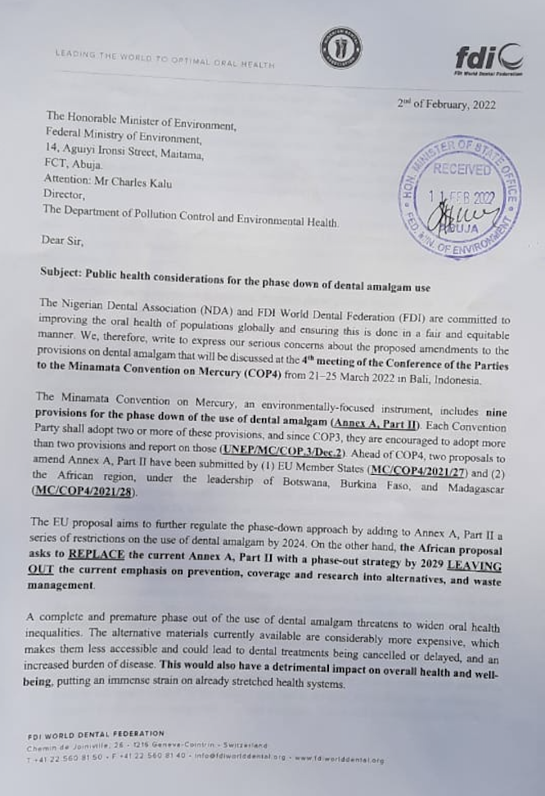
FDI/ NDA LETTERS TO THE HONOURABLE MINISTERS OF HEALTH AND ENVIRONMENT ON PHASE DOWN OF AMALGAM USE

Slide 9
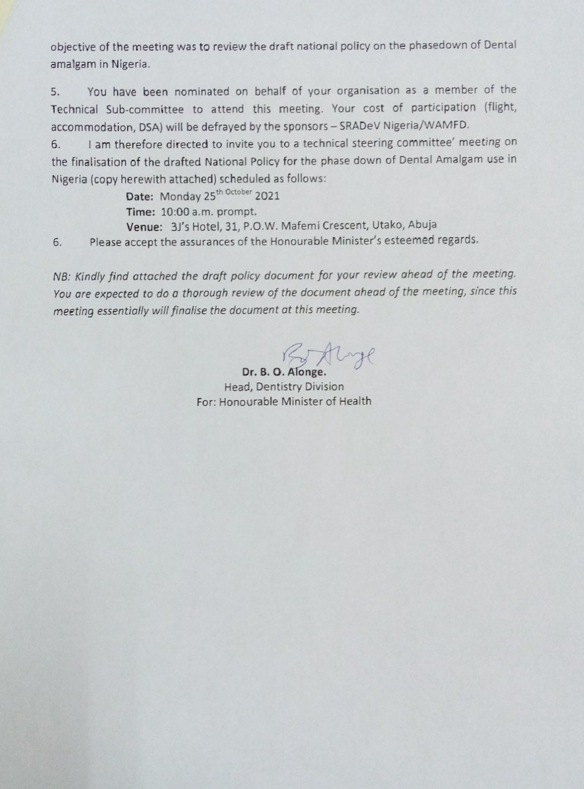
INVITATION A SUB-COMMITTEE MEETING ON NATIONAL POLICY ON DENTAL AMALGAM PHASE DOWN IN NIGERIA

Slide 10
STAKEHOLDERS’ MEETING ORGANIZED BY THE MINISTRY OF ENVIRONMENT ON IMPLEMENTATION OF THE MINAMATA CONVENTION ON MERCURY IN NIGERIA

Slide 11
PROGRESS SO FAR

Slide 12
SUMMARY OF KEY ACTION AREAS
The phase down strategy should begin with a phase down in children <15 years and pregnant and breast feeding women (15 - 39years) without delay.
Discontinuance of insurance payment for dental amalgam in vulnerable groups by NHIA.
Update of our National Oral Health Policy integration of the WHO recommended BPOC into all programs and promotions of primary healthcare by the PHCDA.
Update of the curricula of the dental faculties in Nigeria
Upgrade of the simulation laboratories of the dental faculties with provision of a self sustaining revolving fund scheme.
Provision of a Dental metaverse academy hub.

Slide 13
RESERVATIONS
Quite a number of our clients still have amalgam fillings in their mouths which were done several years ago without negative health consequences.
The country still uses amalgam in training dental students following GV blacks classification in order to have hands-on.
The alternatives to dental Amalgam are quite expensive and we hope there will be reduced taxes to make them affordable.
There is no time-tested research on the alternatives.

Slide 14
National Liaison Officer and Past President, Nigerian
Dental Association - Dr. Oluwarotimi Clement
Nigerian Dental Association’s
President - Dr. Kolawole Obagbemiro.
Immediate Past President - Dr. Evelyn Eshikena.
Past President – Dr. Ijarogbe Olabode

Slide 15
THANK YOU FOR LISTENING

