Slide 1
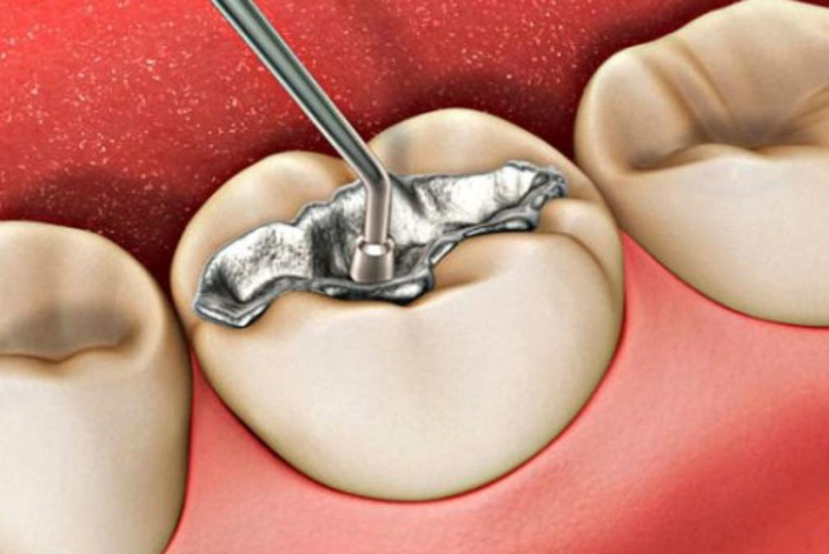
“GUIDELINES FOR THE CONTROLLED USE OF DENTAL AMALGAM IN COLOMBIA” Minamata Convention.
2022
Maria Fernanda Atuesta Mondragón
Council – FDI
President – Colombian Dental Federation

Slide 2
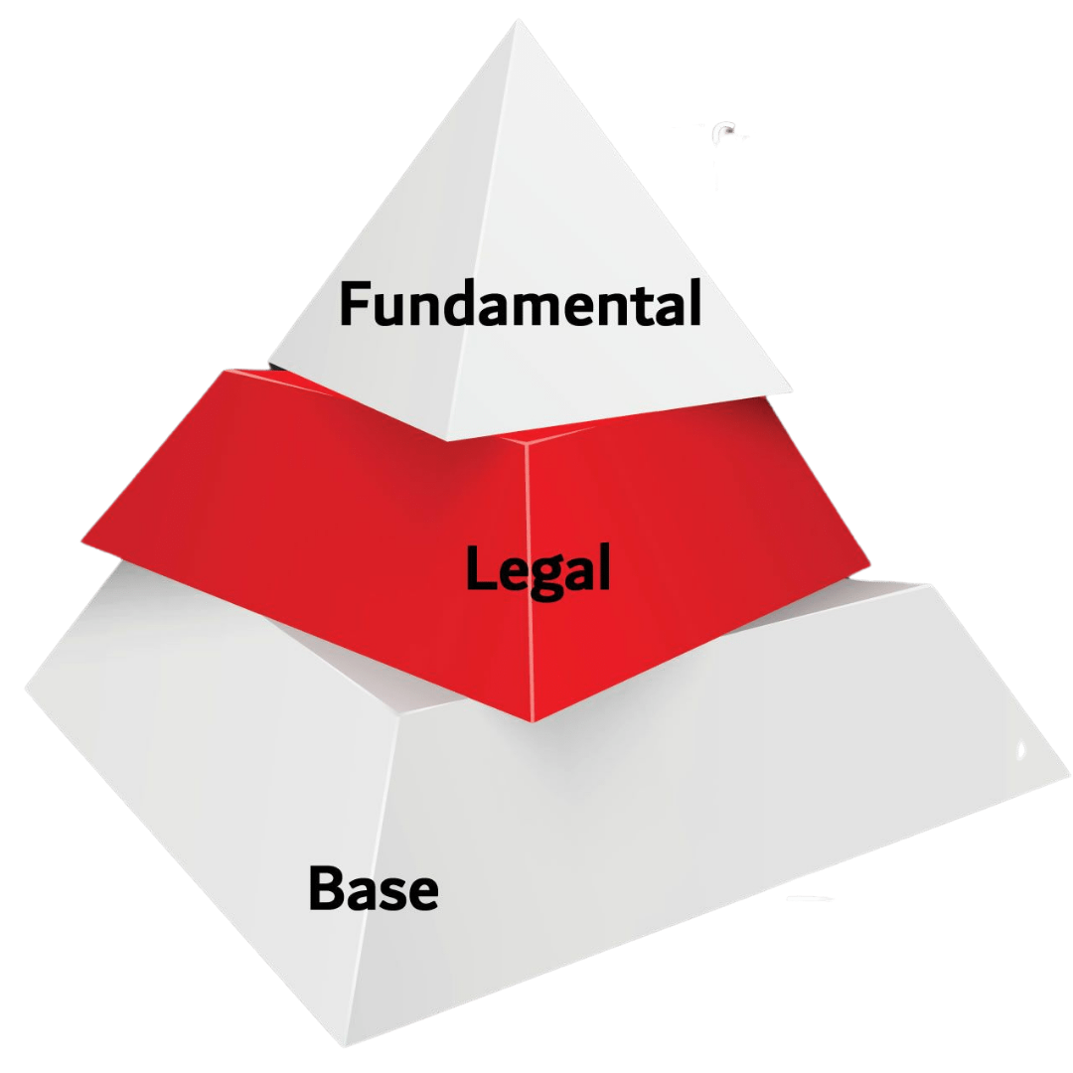
Constitución
Pacto Internacionales
What are the guidelines or routes established for the controlled use
of amalgam in oral health services in Colombia?
LEGAL
Leyes Orgánicas -Especiales
Leyes Ordinarias -Decretos
Reglamentos
Ordenanzas
Sentencias

Slide 3
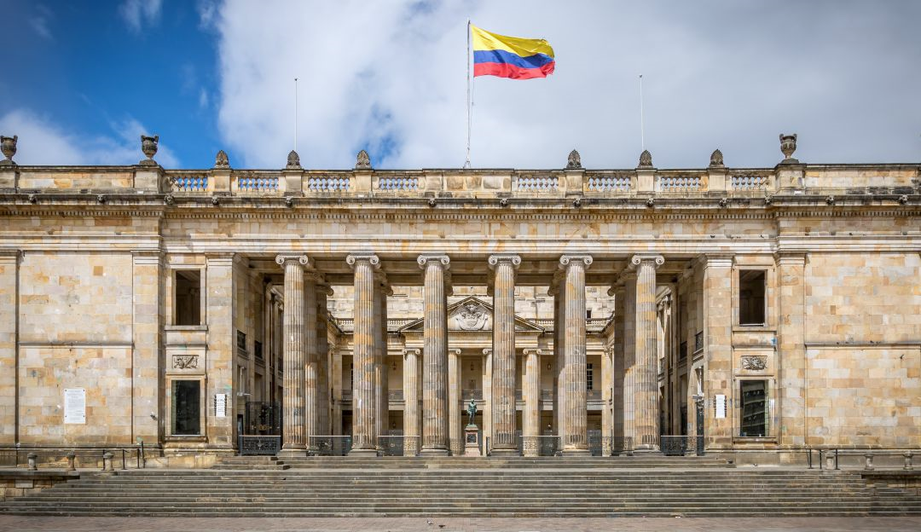
LAW 1658 / 2013
Establishes provisions for the commercialization and use of mercury in different industrial activities in the country.
LAW 1892 / 2018
By which the "Minamata Convention on Mercury" is approved

Slide 4
Colombia has adopted some measures to advance in the objectives set by national laws and by the Minamata Convention and follows public health policy guidelines, in which the country has made the the following progress:

Slide 5
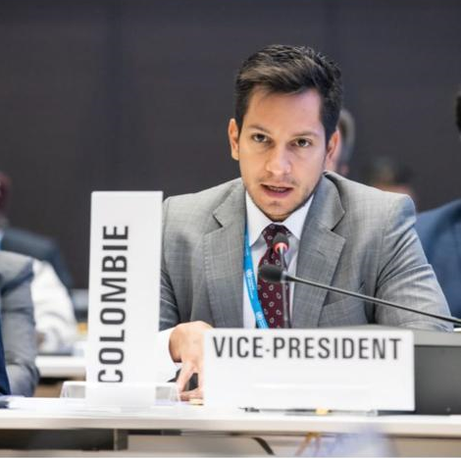
Establish national goals for the prevention of dental caries and the promotion of health, in order to minimize the need for dental restoration
1.
20% increase in self-care practices for the prevention and management of non-communicable diseases, oral health
Annual increase in the number of allied organizations that promote healthy life-styles.
20% increase in the country’s population without caries, with an emphasis in early childhood, infancy and adolescence. Dental Caries Index (COP=0)
,
20% increase in the population over 18 years without tooth loss due to preventable oral disease
Since 2012, national objectives that contribute to said aim have been included into the Ten-Year Public Health Plan (Resolution No. 1841 of 2012), as ordered by the Law No. 1438 of 2011, such as:

Slide 6
2.
Establish national goals where 100% of oral health professionals meet the guidelines for the controlled use of fluoride and mercury.
Since 2012, national objectives that contribute to said aim have been included into the Ten-Year Public Health Plan
(Resolution No. 1841 of 2012), as ordered by the Law No. 1438 of 2011, such as:

Slide 7
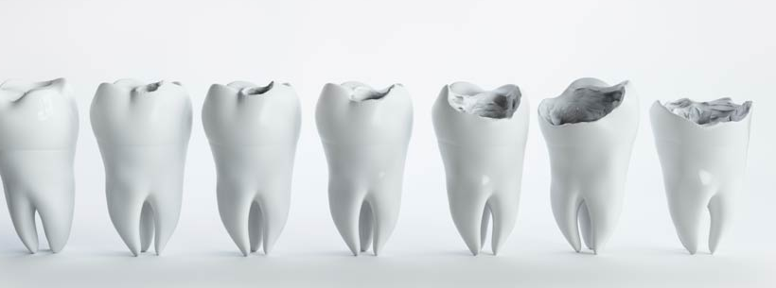
Invite health providers to promote health prevention and promotion actions that control the presence and progression of caries.
3.
Resolution 3280 of 2018.

Slide 8
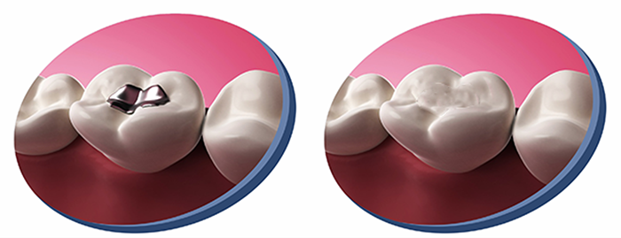
Establish national objectives aimed to the
reduce the use of amalgam to the minimum and promote non mercury obturation such as composite resin or glass ionomer.
4.

Slide 9
Encourage professional representative organizations and dental schools to educate and train professional dentists and students on the use of non-mercury alternatives.
5.
Comprehensive Health Care Routes, defined in the Comprehensive Health Care Policy
(Resolution No. 2626 of 2019).

Slide 10
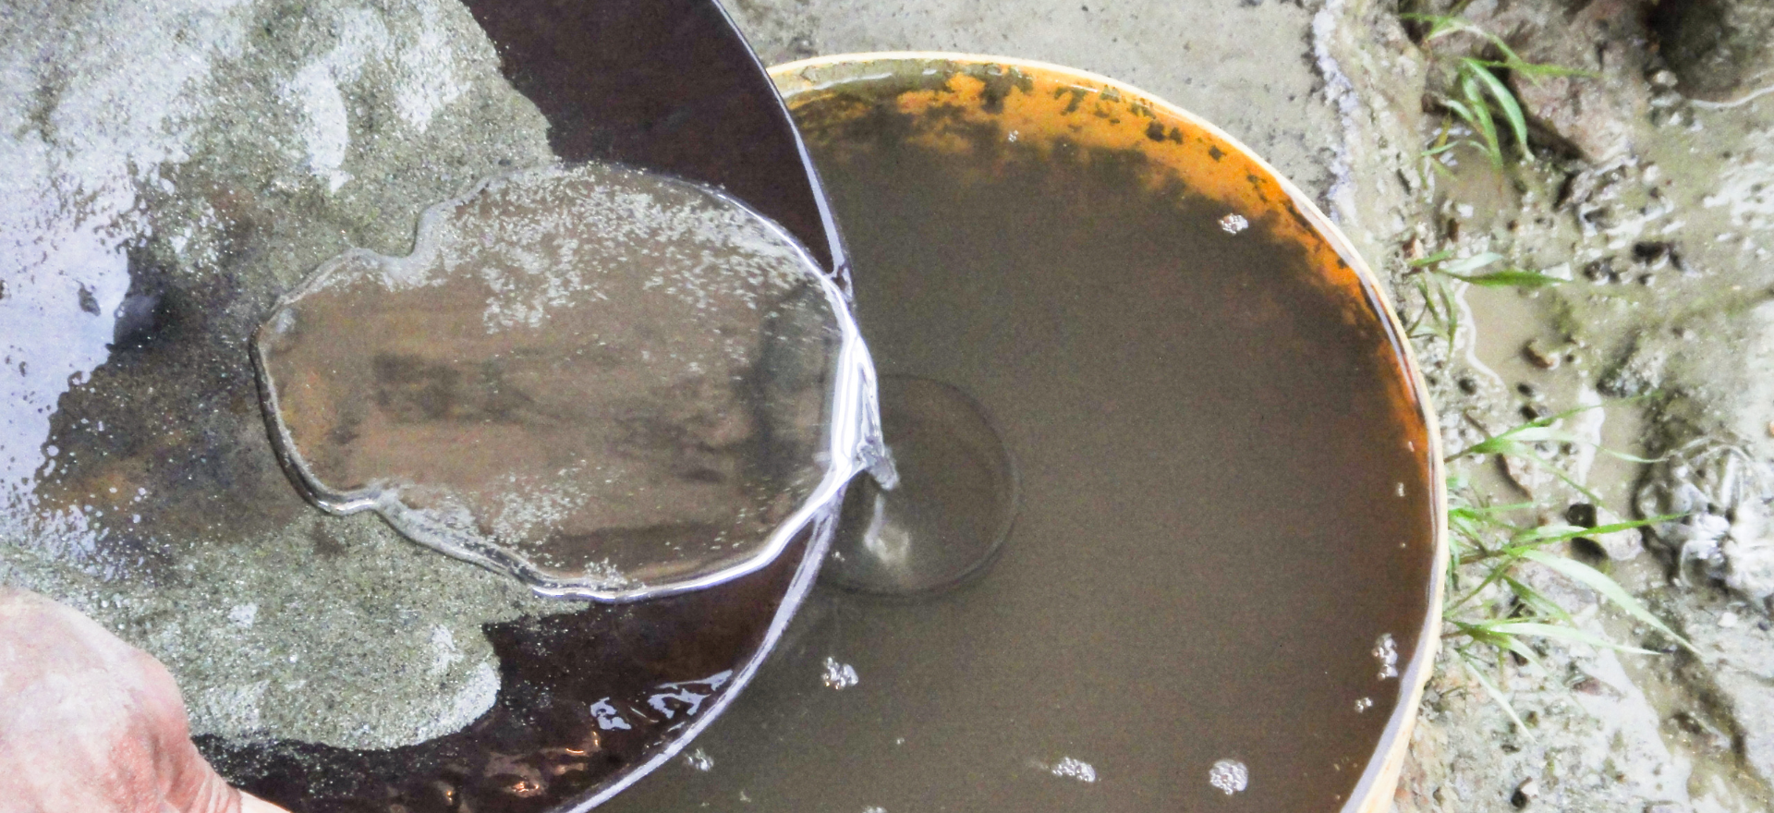
Promote the use of the best environmental practices in dental clinics to reduce the emissions of mercury and mercury compounds to water and
the ground.
6.
Comprehensive Health Care Routes, defined in the Comprehensive Health Care Policy
(Resolution No. 2626 of 2019).

Slide 11
The Ministry of Health and Social Protection’s position prior to being part of the Minamata Convention
It has manifested not accepting the modification proposals presented by the African countries in Part II of the Annex A of the Convention
This position has been run by the Colombia Chancellery - Ministry of Foreign Affairs, according to the protocol defined for such purposes. The position is based on the available international evidence, in pursuit of improving oral health. Recommendation of the FDI and CDF.

Slide 12
IMPORTANT CONCLUSIONS OF THE WORK DONE IN COLOMBIA
Establish national goals on caries prevention and the controlled use of fluor and obturations in amalgams.
2. Even though research concerning the associated effects to the exposition and use of dental fillings in children younger that 6 years and pregnant people.
3. The financing of restoration materials different to dental amalgams, such as resins and ionomers, which in the Colombian system have been financed since 1993 with the Law 100.
4. There is an articulated work with dental institutions, aiming to promote research, development and use of measures to prevent sickness and use anticipatory actions, as well as the implementation of preventive techniques and more conservative materials.

Slide 13
IMPORTANT CONCLUSIONS OF THE WORK DONE IN COLOMBIA
5. Strengthening of specific protection actions for the control of other conditions and of caries, that are included in the Comprehensive Care Route for Health Promotion.
6. Control of the use of dental amalgams in its encapsulated form, through the competences established for the Food and Drug Surveillance Institute – INVIMA.
7. Promotion of the use of the best environmental practices in dental services, to reduce the emissions of mercury and mercury compounds to water and soil, which is achieved in an articulated work with local authorities and the Ministry of Environment and Sustainable Development.

Slide 14
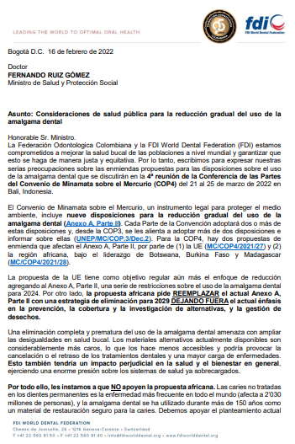
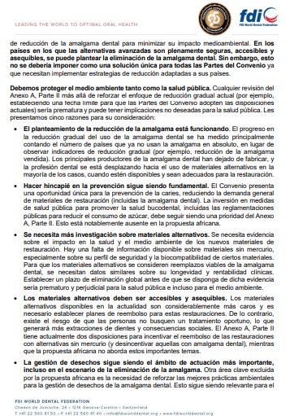

Slide 15
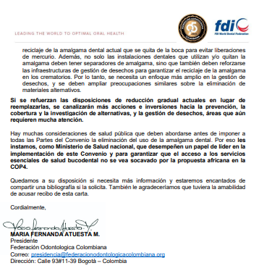
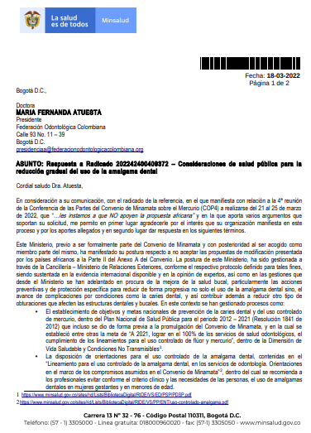
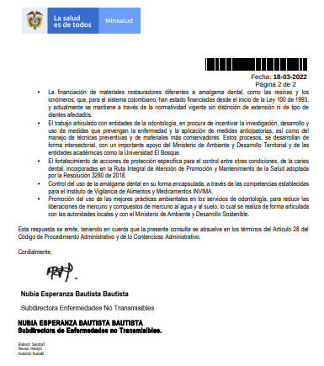

Slide 16
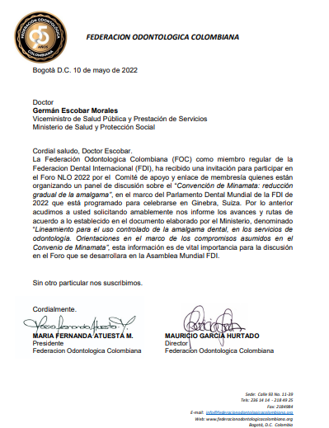
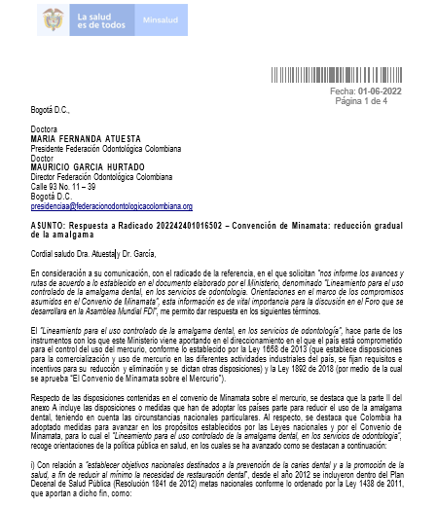

Slide 17
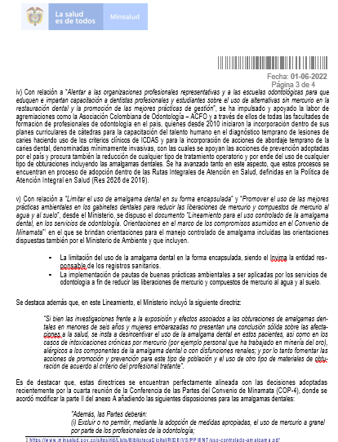
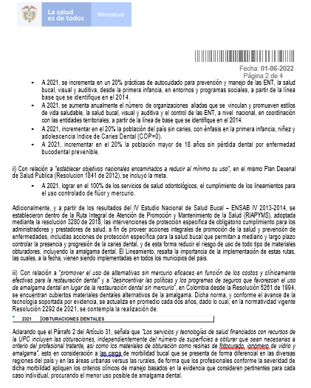

Slide 18
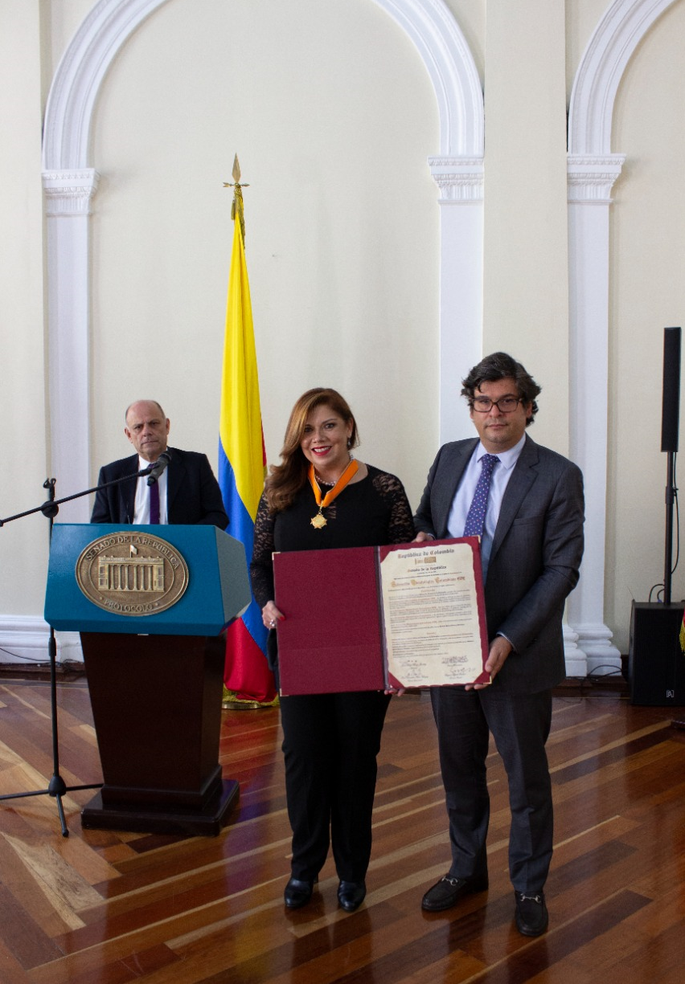
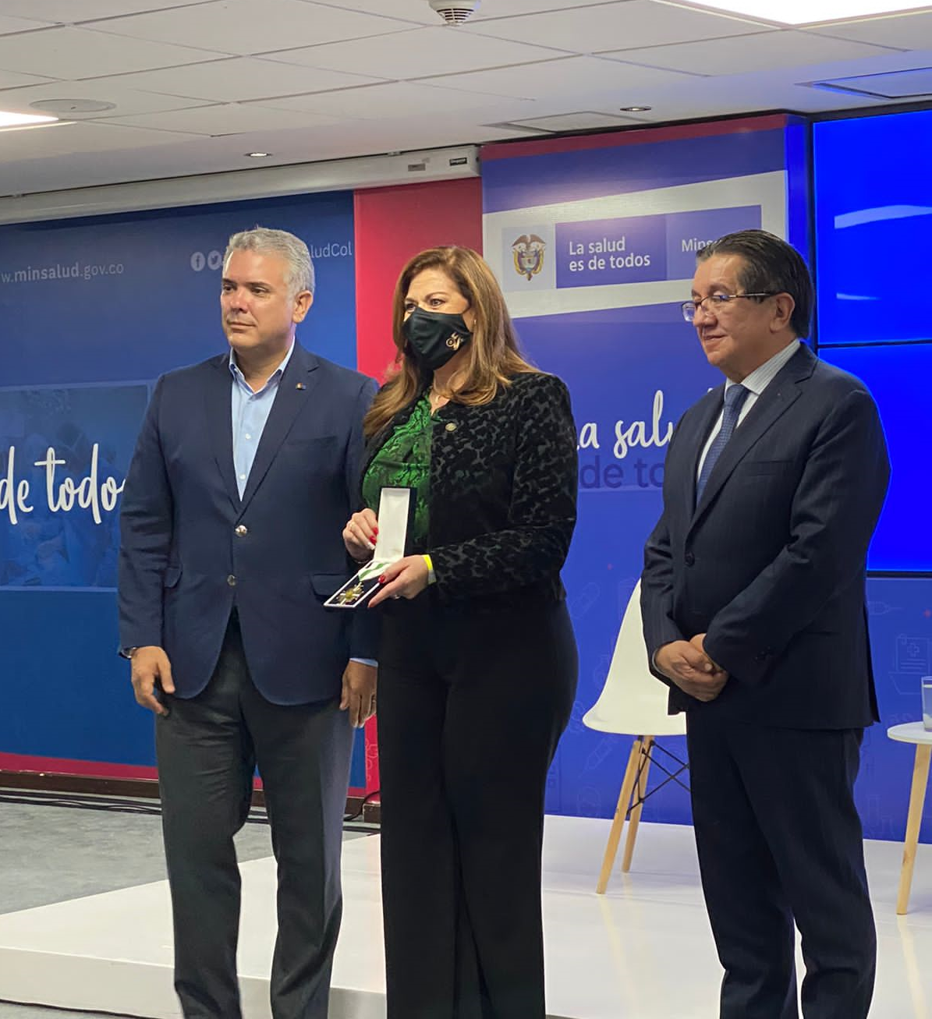
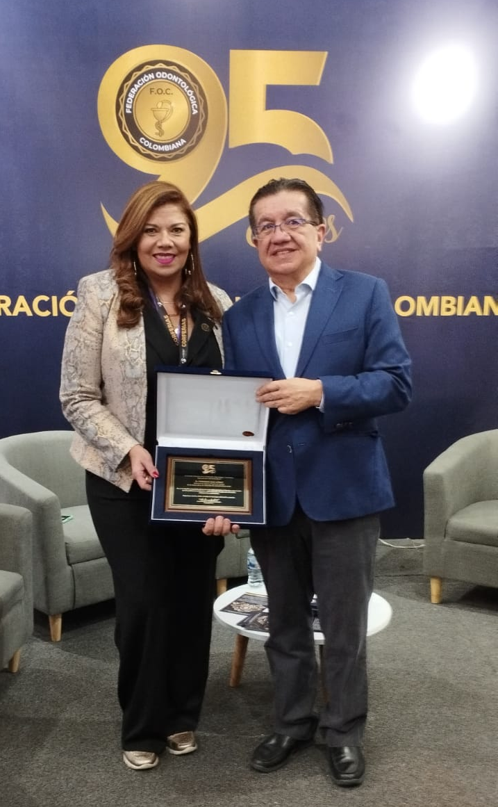
Recognition of the Congress of the Republic of Colombia delivered the degree of Commander to the Colombian Dental Federation
Civic Cross Plate recognition and Jorge Bejarano care merit to all Human Talent in Health
Tribute to the Minister of Health Within the framework of the VI VERSION OF ODONTOTECH 2022

Slide 19
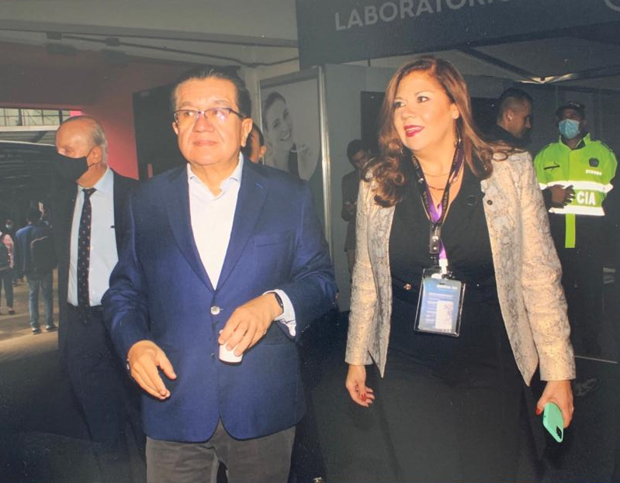
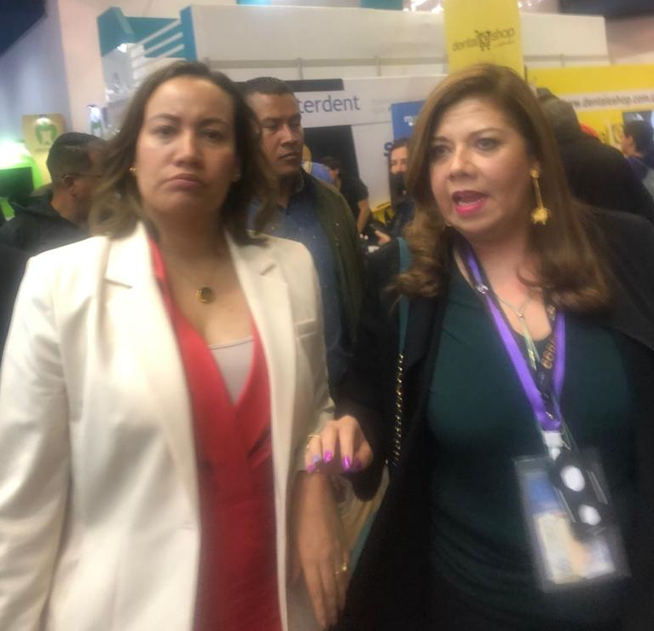
Participation of the former Minister of Health in the VI Edition of Odontotech - 2022.
New Minister of Health of Colombia

Slide 20
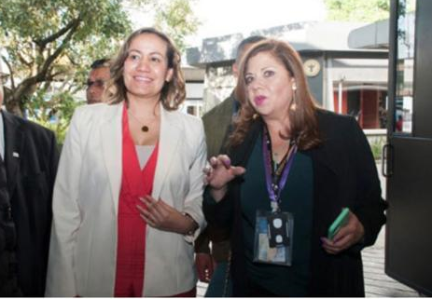
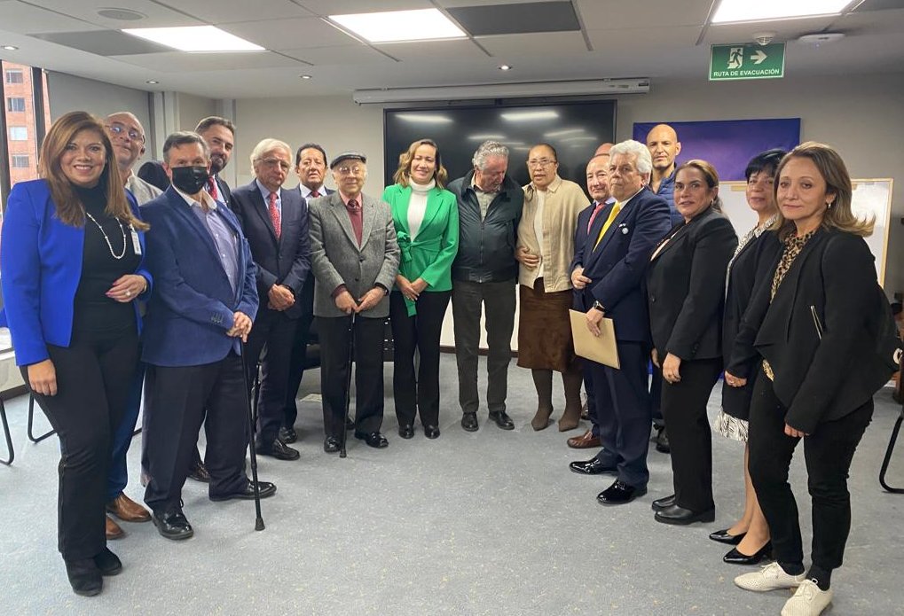
August - September 2022

Slide 21
THANK YOU
Maria Fernanda Atuesta Mondragón
Council – FDI
President – Colombian Dental Federation

