Slide 1
Minamata Convention Amalgam Phase Down
Bulgarian Dental Association Activities & Experience
Asst. Prof. Dr. Nikolai Sharkov
President of Bulgarian Dental Association
FDI Treasurer

Slide 2
Bulgarian Dental Association Experience & Activities
The Bulgarian Dental Association (BgDA) played an essential role in the process of preparing, writing and implementation of the National Plan for Measures to Phase-down the Use of Dental Amalgam in the Republic of Bulgaria, RD-01-295/23.10.2019, approved by the European structures.

Slide 3
Bulgarian Dental Association Experience & Activities
Bulgarian National Plan
Dental amalgam, where it is used, is only in a dosed, encapsulated form, which logically indicates that mercury is not used in bulk;
Dentists, with a special declaration, approved my the MH, guarantee that they do not use and remove dental amalgam, and those of them that remove dental amalgam are equipped with amalgam separators;
Dental amalgam is not used in children under 15 years of age, pregnant and lactating women. These texts also appear in the National Framework Agreement 2020-2022 for dental activities;

Slide 4
Bulgarian Dental Association Experience & Activities
Bulgaria has fulfilled one of the main requirements for reducing the use of dental care by preventing oral diseases. In 2009, the Council of Ministers adopted a National Program for the Prevention of Oral Diseases in Children from 0 to 18 Years of Age in the Republic of Bulgaria, for which the Ministry of Health is responsible. The program entered its third program period until 2025, again by decision of the Council of Ministers. One of the main goals of the complex program is to reduce dental caries in children.

Slide 5
Bulgarian Dental Association Experience & Activities
№ 04-09-9 /27.01.2022
Regarding: Information for the purposes of reporting, according to Art. 21 of the Minamata Convention on mercury, for the measures taken in relation to dental amalgam
DEAR DOCTOR SHARKOV,
“In connection with a letter received by the Ministry of Health with entry No. 04-09-9/27.01.2022 from the Ministry of Environment and Water, with a request to provide information for the purposes of reporting, according to Art. 21 of the Minamata Convention regarding mercury and, more specifically, regarding the effectiveness of the measures taken regarding dental amalgam, please submit information on activities implemented by March 15, 2022…
Dr. Petar Gribnev
Deputy minister Ministry of Health”

Slide 6
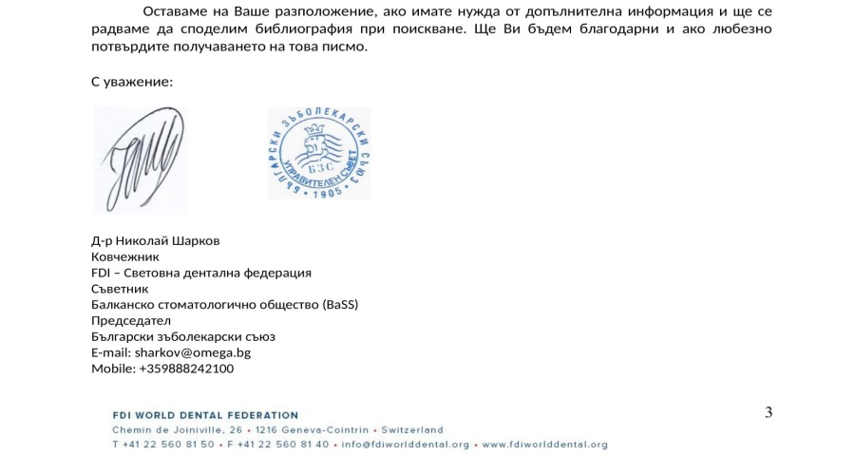
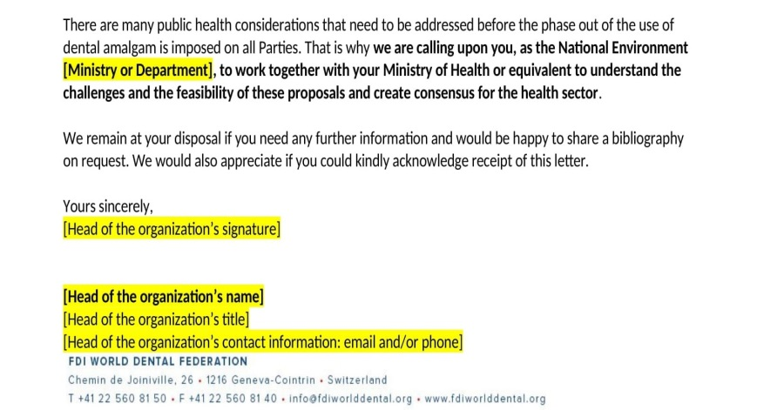
Bulgarian Dental Association Experience & Activities
……………………………………………..

Slide 7
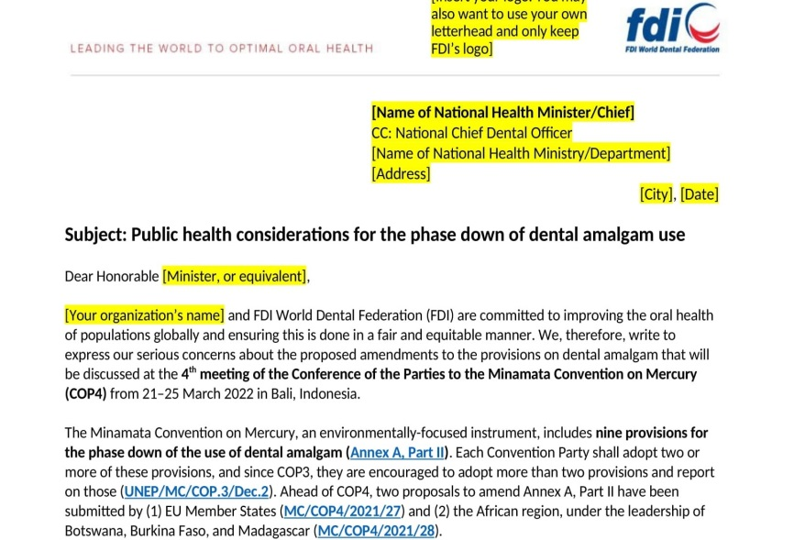
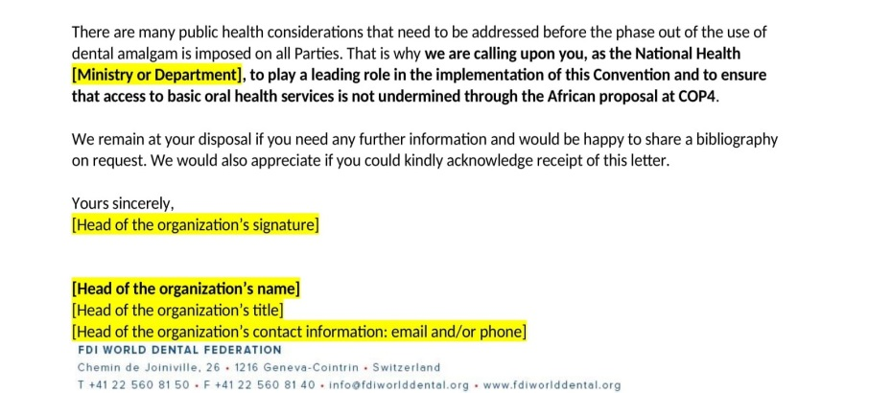
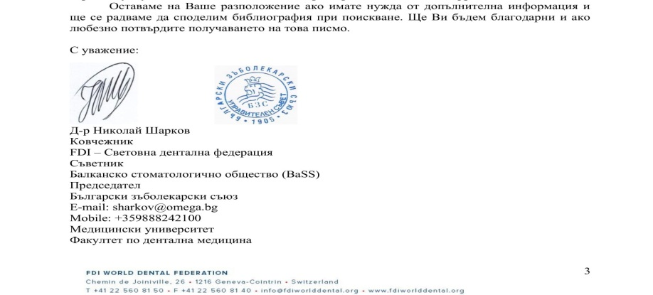
Bulgarian Dental Association Experience & Activities

Slide 8
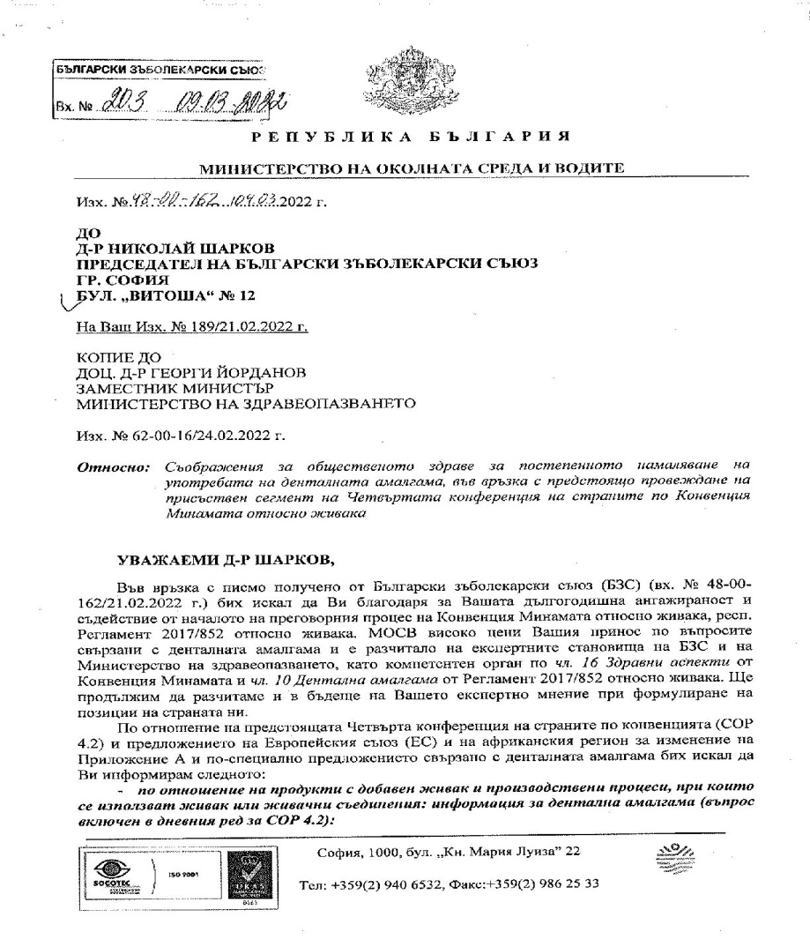
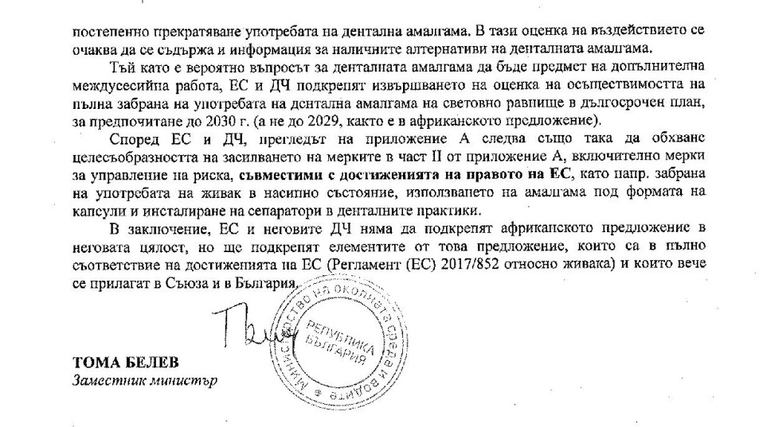
Bulgarian Dental Association Experience & Activities
During COP 4.2 Bulgaria will not support a decision to completely ban the production, import and use of dental amalgam at the national level, as this goes beyond the current acquits of the EU.

Slide 9
Conference of the Parties to the Minamata Convention on Mercury (COP4.2) - Results
Results of the second in-person segment of the fourth meeting of the Conference of the Parties to the Minamata Convention on Mercury (COP4.2):
Parties rejected the Africa region’s proposal to ban dental amalgam and adopted a decision to further strengthen the current phase-down approach.
Approved two new provisions to limit the use of mercury in bulk form and recommend against the use of dental amalgam in deciduous teeth, of patients under 15 years and of pregnant and breastfeeding women, except when considered necessary by the dentist (existing text in the EU Regulation 217/852 concerning mercury).

Slide 10
Thank you!
Q & A

