Slide 1
Minamata Convention on Mercury
NLO Forum 2022
Enzo Bondioni, Executive Director

Slide 2
P
What’s happened since we last met? Progress update
Notes:
I will start by first going back to what I mentioned during the last time we met online for the NLO Forum in 2021
This recap may also be useful to those of you who may not have been present
I also mentioned this in my presentation to the General Assembly
NEXT SLIDE

Slide 3
P
The Minamata Convention has nine provisions for the phase down of the use of dental amalgam in Annex A, Part II. At the second segment of the Conference of the Parties (COP 4.2), which took place in Bali (Indonesia) from 21–25 March 2022, two proposals to amend this section were up for discussion.
Notes:
To remind you, the Minamata Convention on Mercury has nine provisions to phase down the use of dental amalgam
Last March, going into COP 4.2 meeting there were two proposals to amend the Convention’s Annex A, (where you have the 9 provision on the use of dental amalgam), one from the EU and another one from the African region.
NEXT SLIDE

Slide 4
Information shared at NLO Forum 2021
Two amendment proposals affecting Annex A, Part II:
EU Member States:
Complemented existing language & restricted phase-down approach by 2024:
only allow pre-dosed encapsulated form of amalgam (no bulk form)
ensure use of quality amalgam separators
forbid use in deciduous teeth, in children under 15 years & pregnant or breastfeeding women (except when deemed strictly necessary by the dental practitioner)
Africa region (Botswana, Burkina Faso & Madagascar):
Replaced existing language, asking phase-out by 2029
Removes any language on investing in prevention/oral health promotion, alternative materials research, and waste management
Notes:
We could live with the EU proposal as it mirrored what is happening right now in the European Union, but we could not with the African proposal.
This proposal was particularly concerning as it pushed for the phase-out of amalgam by 2029 without action and investment into caries prevention, research into mercury-free alternatives, and waste management.
FDI’s position has always been that we support the phase-down but phase out will not be a reality until there is global access to quality, effective, durable, affordable and safe alternatives. Which also must be environmentally friendly.
So, you remember, we were extremely concerned with the African proposal.
NEXT SLIDE

Slide 5
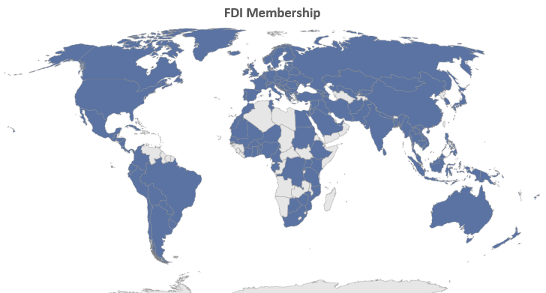
We asked members to
UNDERSTAND your government’s position
GET INVOLVED in advocacy for a phase-down approach
CONNECT your Ministries of Health and Environment and plan strategies together
Notes:
[Read slide]
And try to connect with the delegation that would represent your country at COP4 and make them understand the public health concerns

Slide 6
Our strategies: status update Minamata
Influence policies: UNEP (Minamata Convention)
January to February 2022
Informational webinars (x3 in English, French, Spanish) to align on messaging and key asks going into COP4.2, reinforced through template letters
21–25 March 2022
Attendance and advocacy at the meeting with joint FDI-IADR statement
11 March 2022
Official COP4.2 joint side event with IADR and ADA on Accelerating the Phase Down of Dental Amalgam
Notes:
In the run up to COP 4.2 we worked a lot with an Expert group comprised of FDI, IADR, ADA and IDM, to strategise on our approach and agree our positioning.
I take this opportunity to thank IADR, ADA & IDM for the great collaboration and I hope you will all see that it was a successful one.
In the run up of COP4.2 in March FDI prepared template letters and shared these with you to use in your advocacy efforts with your respective ministries of health and environment
To our knowledge, members contacted ministries with our concerns on the African proposal by using FDI template letters in 16 countries (and for instance, Thailand’s intervention at COP4.2 replicated some of the letters’ messages)
Give the Belgian example - Arden – Ministry of environment
Thank you to all of you who lent your voice to this effort
FDI also held multilanguage informational webinars for our members
And on 11 March in the run up to COP4.2, FDI, IADR and ADA hosted an official side event on Accelerating the Phase Down of Dental Amalgam – 3 other side events – ours was the most professional
FDI and IADR also submitted a joint written statement echoing the public health concerns of the oral health community on the phase-out proposal by the African region and used it as an opportunity to reinforce our key messages, asks and concerns
NEXT SLIDE

Slide 7
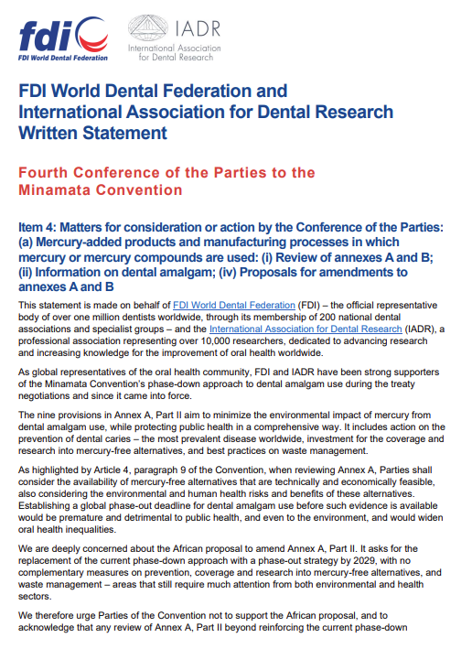
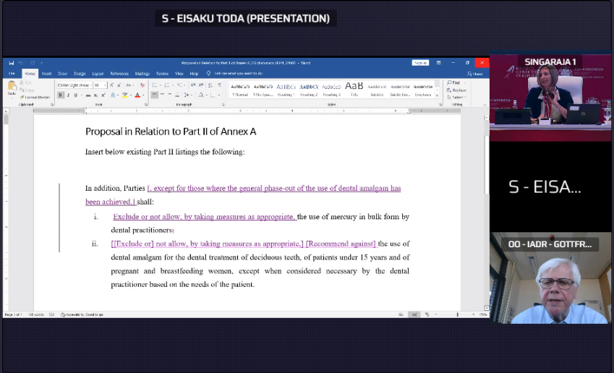
Advocacy in action
21–25 March in Bali, Indonesia
FDI HQ followed COP4.2 online, and we were represented onsite by 2 members of the Indonesian Dental Association: Dr Rudi Wigianto, Dr Armelia Sari Widyarman.
Many Parties shared their concerns about the restrictiveness of the African and EU amendment proposals, asking for the review of annexes A and B to consider different national circumstances.
Negotiations to review annexes A and B were followed closely and Prof. Gottfried Schmalz made one intervention on behalf of FDI and IADR during the discussions.
Notes:
Although FDI Headquarters team participated in COP4.2 virtually, I would like to thank the Indonesian Dental Association for attending the meeting in person in Bali and representing FDI.
So, a big thank you for supporting us on the ground.
The FDI, IADR, ADA & IDM teams were in close contact and corresponding through the sessions and strategizing on approach and any necessary interventions as well as language recommendations on the spot. Prof. Schmalz, who was expert for FDI & IADR, made one intervention during the meeting.
NEXT SLIDE

Slide 8
Our impact: highlights
Parties rejected the Africa region’s proposal to ban dental amalgam and adopted a decision to further strengthen the current phase-down approach.
Following text added to the existing nine phase-down provisions in Annex A, Part II:
“In addition, Parties shall: (i) Exclude or not allow, by taking measures as appropriate, the use of mercury in bulk form by dental practitioners; (ii) Exclude or not allow, by taking measures as appropriate, or recommend against the use of dental amalgam for the dental treatment of deciduous teeth, of patients under 15 years and of pregnant and breastfeeding women, except when considered necessary by the dental practitioner based on the needs of the patient.”
Notes:
Thanks to our united efforts we managed to secure a great result where parties rejected the Africa region’s proposal to ban dental amalgam (and actually also the EU) and adopted a decision to further strengthen the current phase-down approach.
They approved two new provisions (in Annex A) to limit the use of mercury in bulk form and recommend against the use of dental amalgam in deciduous teeth, of patients under 15 years old and of pregnant and breastfeeding women, except when considered necessary by the dental practitioner.
This is an excellent example of what effective advocacy can achieve and why we rely on all of you, our members, to reinforce our messages and efforts on a national level
By uniting efforts and speaking with one voice we can truly make a difference.
NEXT SLIDE

Slide 9
Conference of Parties (COP5) 28 October to 4 November 2023, Geneva, Switzerland
Notes:
We are working with the expert group to plan for COP5 taking place from 28 Oct to 4 Nov next year
NEXT SLIDE

Slide 10
Resolution on oral health and its mandate
11. In the resolution, Member States also requested the Director-General to develop a draft global strategy on tackling oral diseases, in consultation with Member States, by 2022; to translate this global strategy, by 2023, into an action plan for public oral health, including a framework for tracking progress with clear measurable targets to be achieved by 2030; to develop technical guidance on environmentally-friendly and less-invasive dentistry to support countries with their implementation of the Minamata Convention on Mercury;
Notes:
But before I end, I want to highlight that language around the Minamata Convention is now embedded into the oral health resolution and resulting mechanisms such as the strategy and action plan.
FDI is monitoring all developments very closely to ensure any follow-up mechanisms reflect our ongoing calls to action with regards ensuring access to affordable, durable cost-effective and environmentally friendly alternatives as well as prioritizing research.
NEXT SLIDE

Slide 11
The Global Strategy on Oral Health
13. As a first step in the implementation of the resolution on oral health, Member States adopted the global strategy on oral health in May 2022 at the Seventy-fifth World Health Assembly (A75/10 Add.1 and WHA75(11)). The strategy is aligned to the Operational Framework for Primary Health Care of 2020; the Global Competency and Outcomes Framework for Universal Health Coverage of 2022; the Global Strategy on Human Resources for Health: Workforce 2030 of 2016; the Global Action Plan for the Prevention and Control of Noncommunicable Diseases 2013–2020; the WHO Framework Convention on Tobacco Control adopted in 2003; resolution WHA74.16 (2021) on social determinants of health; decision WHA73(12) (2020) on the Decade of Healthy Ageing 2020–2030; and resolution WHA67.11 (2014) on public health impacts of exposure to mercury and mercury compounds: the role of WHO and ministries of public health in the implementation of the Minamata Convention.
Notes:
Further to the resolution the global strategy highlights the role of WHO and Health ministries in implementing the Convention.

Slide 12
Action plan target
Notes:
It is encouraging, to see that the global action plan refers to phase down with a specific Global target on environmentally sound practices
As shown on the slide the target reads: By 2030, 90% of countries will have implemented two or more of the recommended measures to phase down dental amalgam in line with the Minamata convention on Mercury or will have phased it out.
We can note that there are actions across stakeholders.
Up until now it is probably fair to say that the convention was quite separate from WHO and more a UNEP mechanism.
Now with the resolution Member States and in particular MOH will have to be implicated.
FDI will make sure we stay on top of all the WHO developments and lend our voice and position on an ongoing basis and keep you informed and engaged with the process.

Slide 13
Thank you!

